Slide 1
JavaScript: Functions
Outline
1 Introduction
2 Program Modules in JavaScript
3 Programmer-Defined Functions
4 Function Definitions
5 Random-Number Generation
6 Example: Game of Chance
7 Another Example: Random Image Generator
8 Scope Rules
9 JavaScript Global Functions
10 Recursion
11 Recursion vs. Iteration
12 Web Resources

Slide 2
Objectives
In this tutorial, you will learn:
To understand how to construct programs modularly from small pieces called functions.
To be able to create new functions.
To understand the mechanisms used to pass information between functions.
To introduce simulation techniques that use random-number generation.
To understand how the visibility of identifiers is limited to specific regions of programs.

Slide 3
1 Introduction
Software design
Break software up into modules
Easier to maintain and debug
Divide and conquer

Slide 4
2 Program Modules in JavaScript
Modules in JavaScript
Functions
Methods
Belong to an object
JavaScript includes many useful pre-defined methods
Combine with programmer-defined methods to make a program

Slide 5
2 Program Modules in JavaScript
Functions
Started by function call
Receive necessary information via arguments (parameters)
Boss-Worker relationship
Calling function
Called function
Return value when finished
Can have many tiers

Slide 6
2 Program Modules in JavaScript
boss
worker1
worker2
worker3
worker4
worker5
Hierarchical boss-function/worker-function relationship.

Slide 7
2 Program Modules in JavaScript
Function calls
Name
Left parenthesis
Arguments separated by commas
Constants, variables or expressions
Right parenthesis
Examples:
total += parseFloat( inputValue );
total += parseFloat( s1 + s2 );

Slide 8
3 Programmer-Defined Functions
Defining functions
All variables declared in function are called local
Do not exist outside current function
Parameters
Also local variables
Promotes reusability
Keep short
Name clearly

Slide 9
4 Function Definitions
Format of a function definition
function function-name( parameter-list ) { declarations and statements }
Function name any valid identifier
Parameter list names of variables that will receive arguments
Must have same number as function call
May be empty
Declarations and statements
Function body (“block” of code)

Slide 10
4 Function Definitions
Returning control
return statement
Can return either nothing, or a value
return expression;
No return statement same as return;
Not returning a value when expected is an error

Slide 11
4 Function Definitions
Writing a function to square two numbers
for loop from 1 to 10
Pass each number as argument to square
return value of argument multiplied by itself
Display result

Slide 12
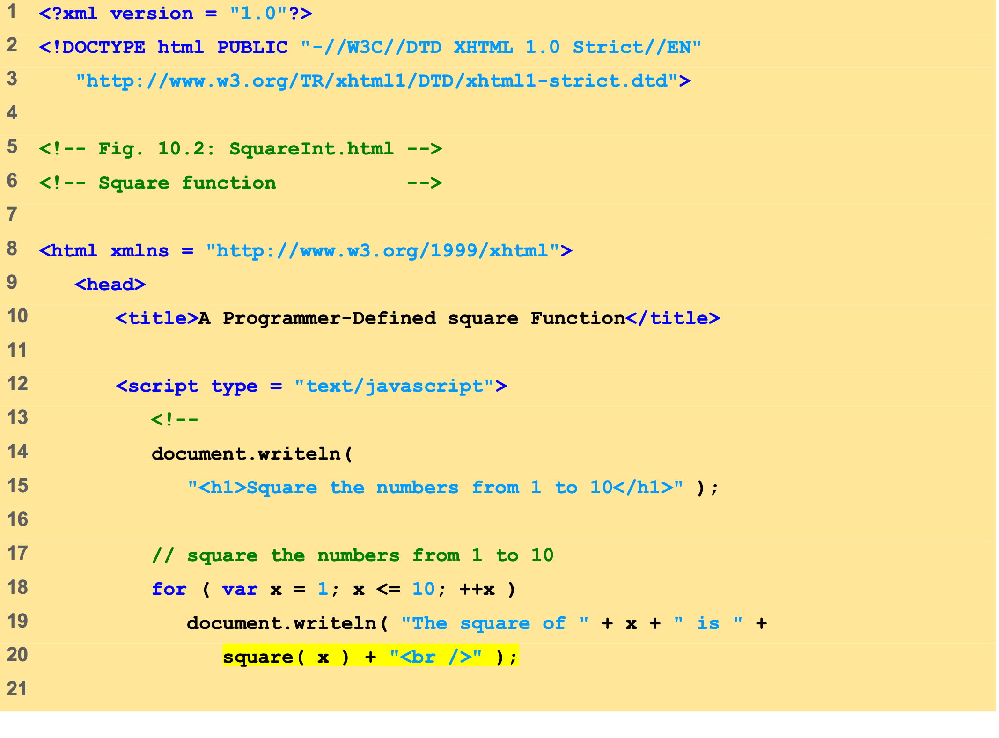
SquareInt.html (1 of 2)
Calling function square and passing it the value of x.

Slide 13
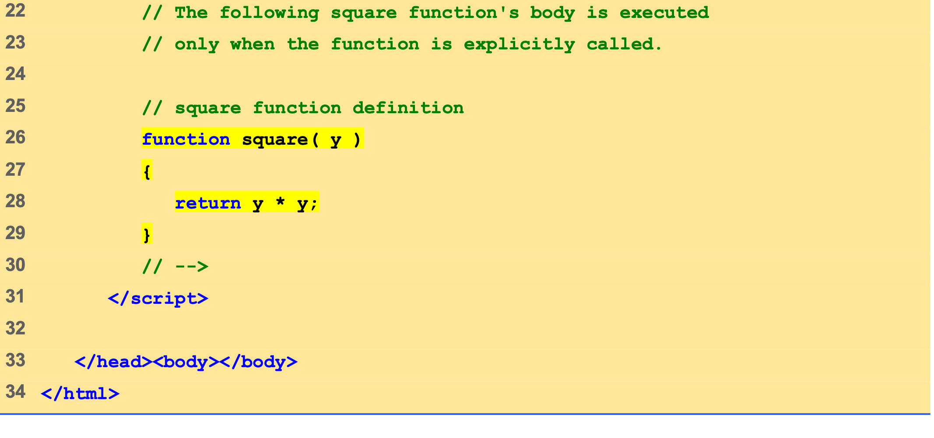
SquareInt.html (2 of 2)
Variable y gets the value of variable x.
The return statement passes the value of y * y back to the calling function.

Slide 14
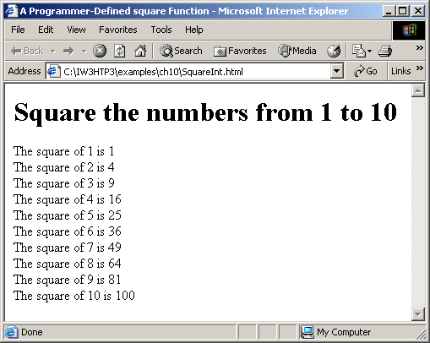
4 Function Definitions
Using programmer-defined function square.

Slide 15
4 Function Definitions
Finding the maximum of 3 numbers
Prompt for 3 inputs
Convert to numbers
Pass to maximum
Math.max

Slide 16
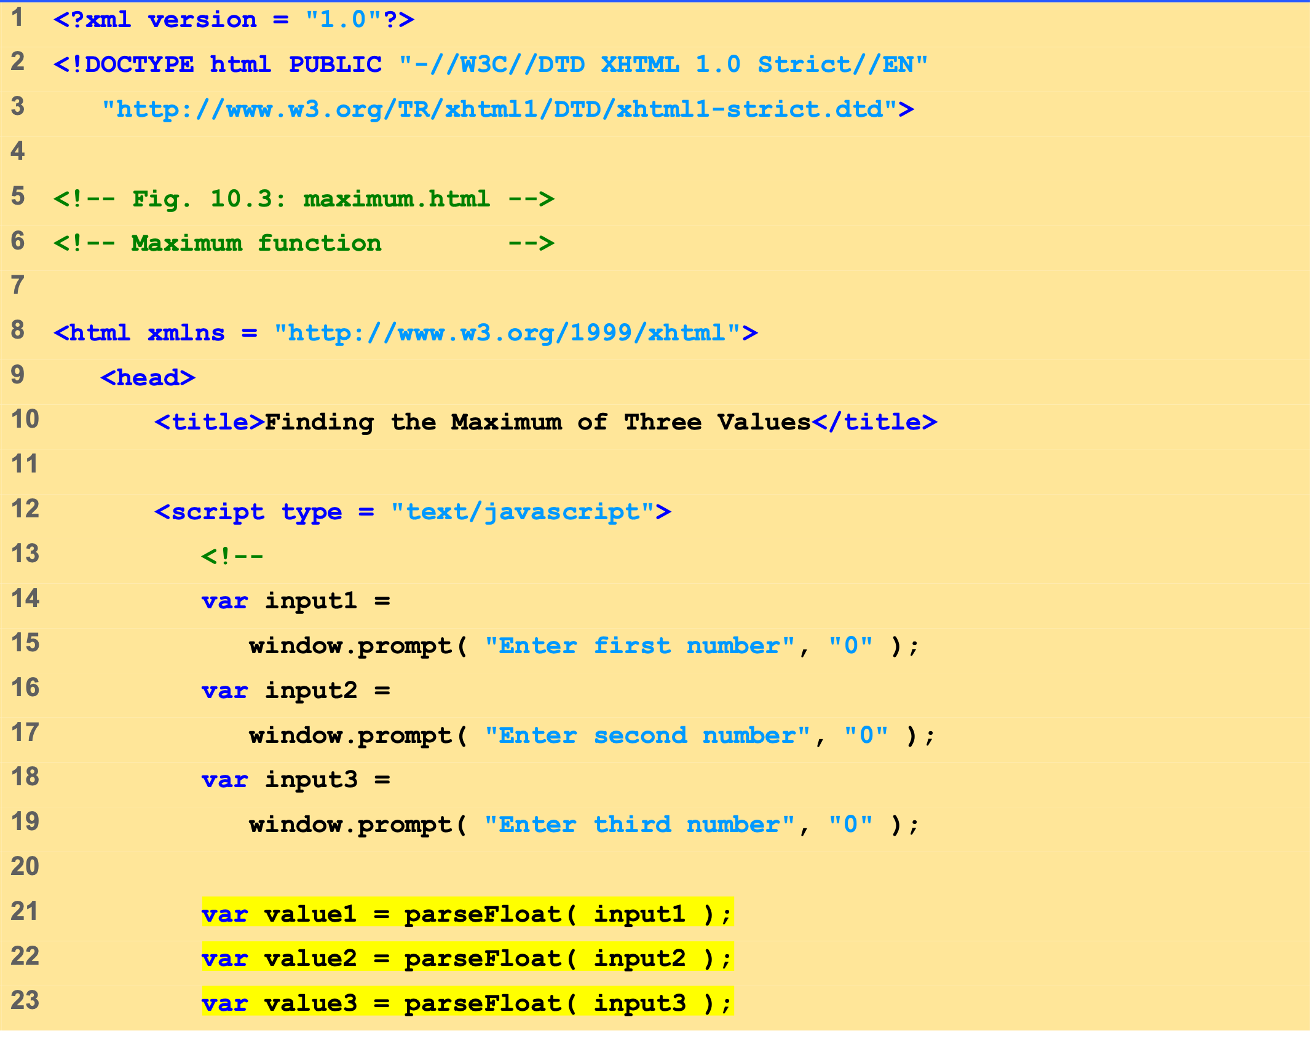
Maximum.html (1 of 2)
Prompt for the user to input three integers.

Slide 17
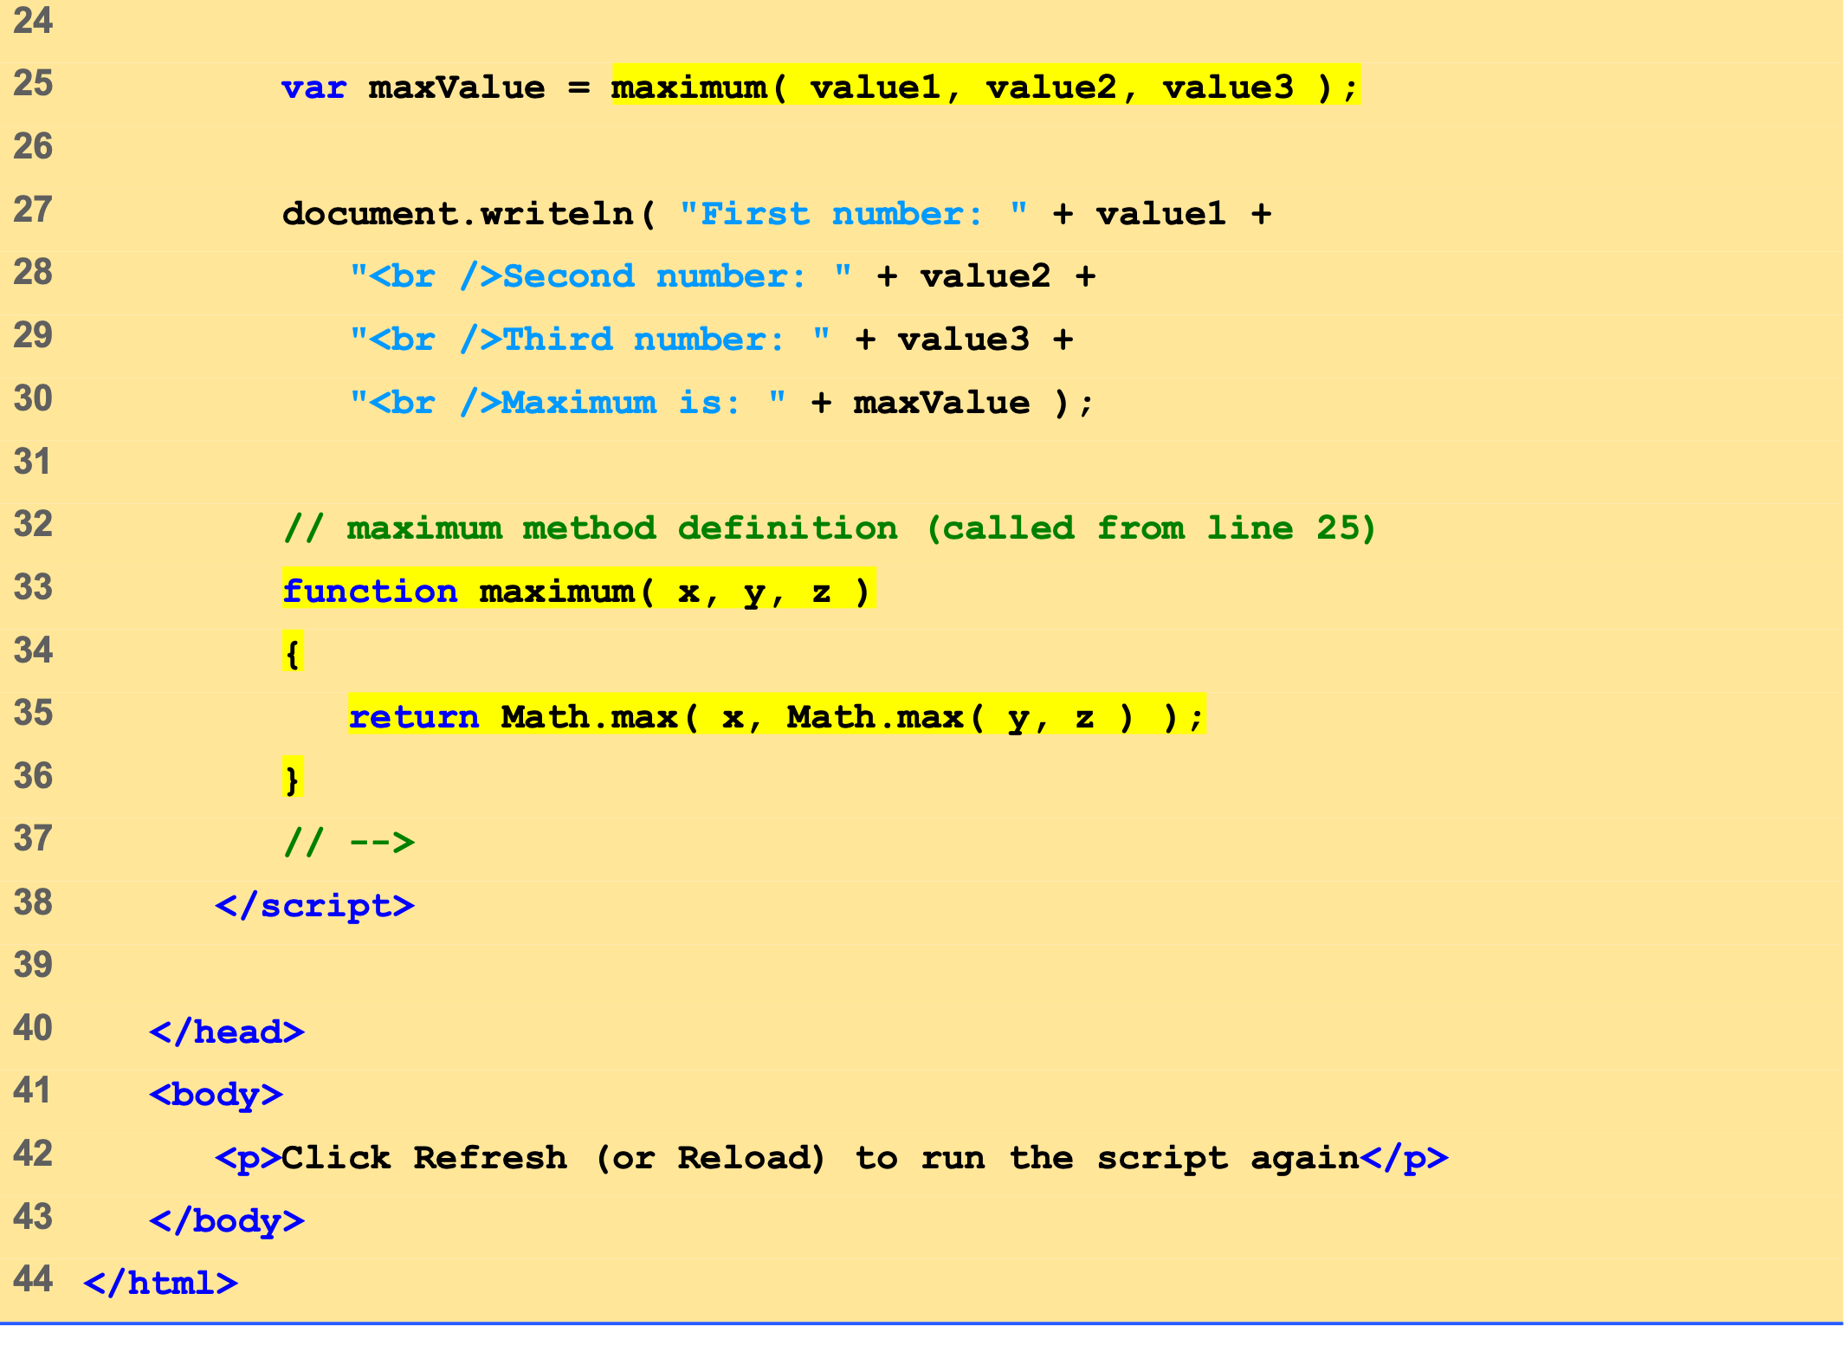
Maximum.html (2 of 2)
Call function maximum and pass it the value of variables value1, value2 and value3.
Method max returns the larger of the two integers passed to it.
Variables x, y and z get the value of variables value1, value2 and value3, respectively.

Slide 18
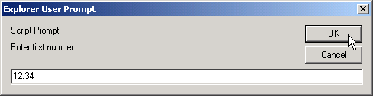
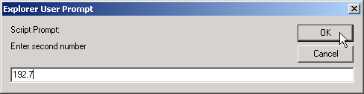

4 Function Definitions
Programmer-defined maximum function (1 of 2).

Slide 19
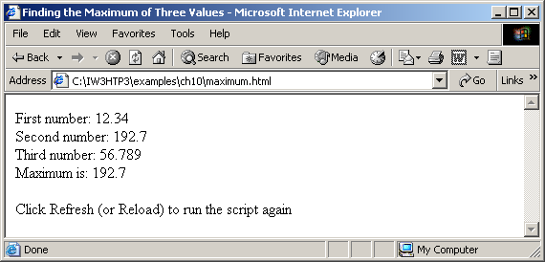
4 Function Definitions
Programmer-defined maximum function (2 of 2).

Slide 20
5 Random-Number Generation
Random-number generation introduces element of chance
Math.random
var randomValue = Math.random();
Floating point value between 0 and 1
Adjust range by scaling and shifting
Math.floor
Always round down
Math.floor( 1 + Math.random() * 6 )

Slide 21
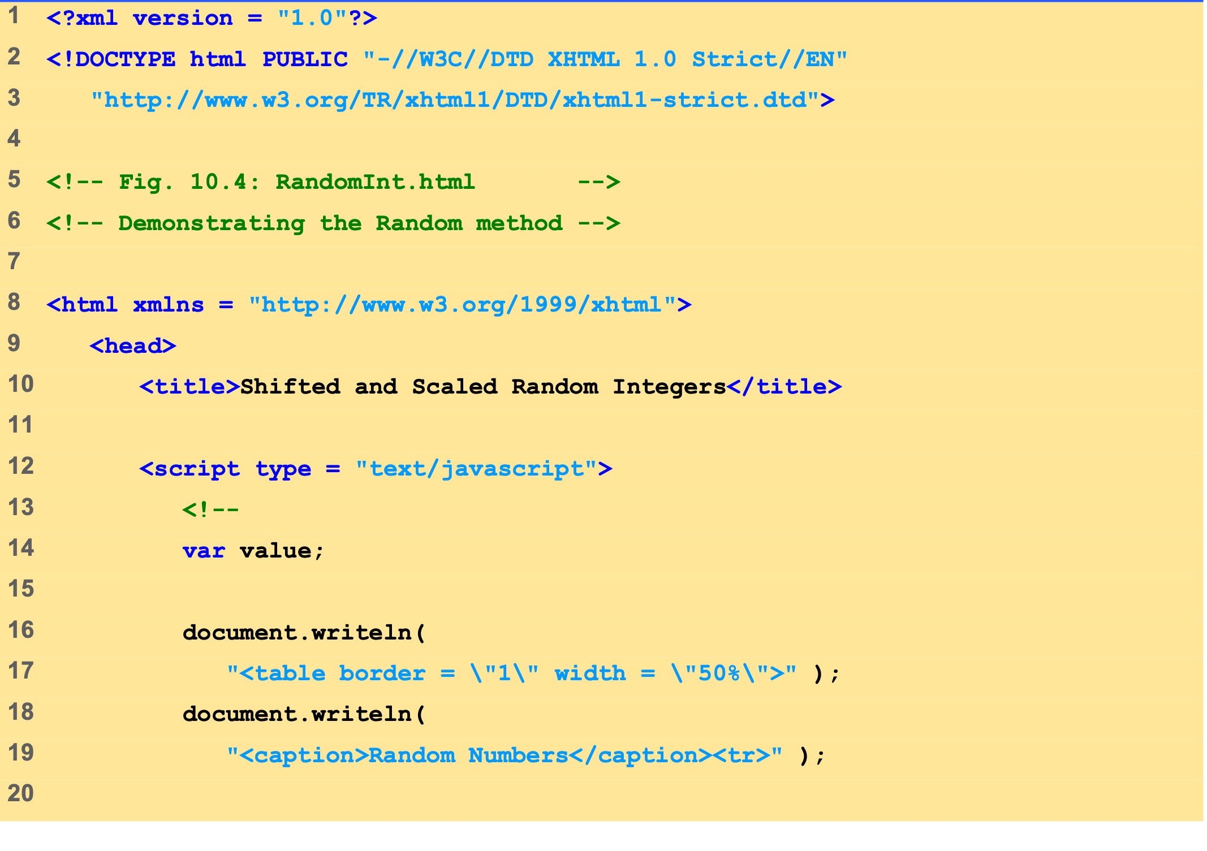
RandomInt.html (1 of 2)

Slide 22
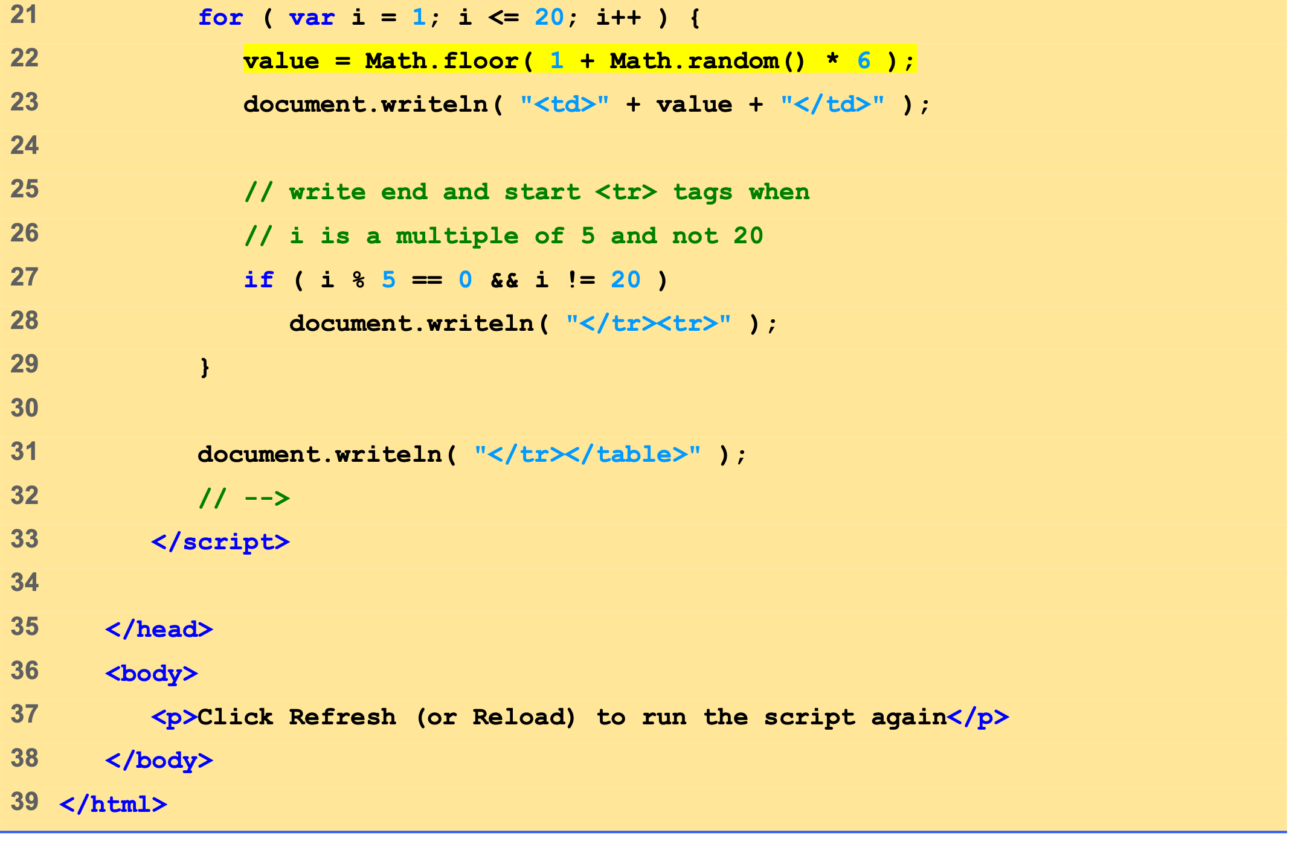
RandomInt.html (2 of 2)
Method floor rounds the number generated by method random down.
Each cell is populated with a random number generated by method random.
The for loop creates 20 table cells (4 rows x 5 columns).

Slide 23
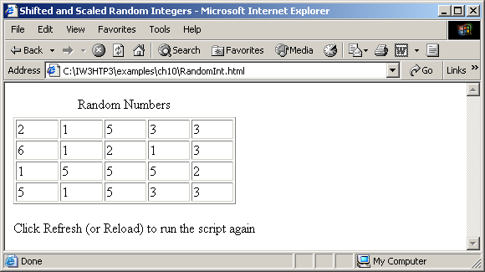

5 Random-Number Generation
Random integers, shifting and scaling.

Slide 24
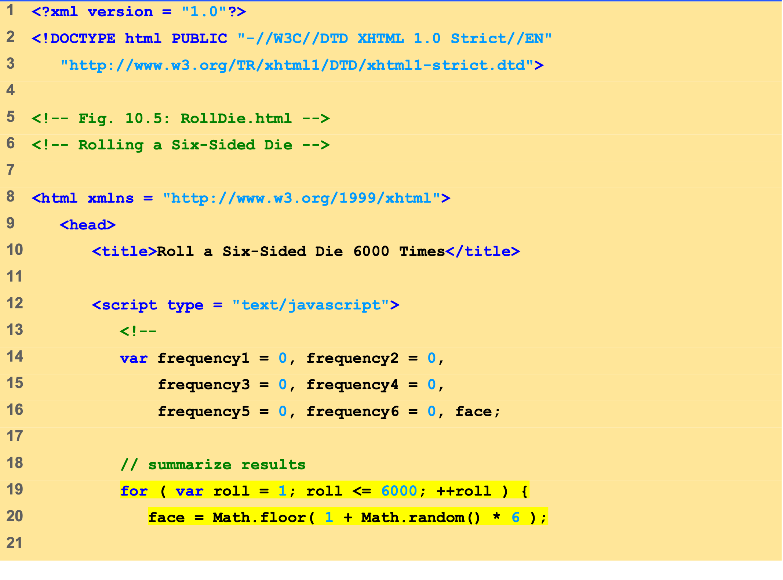
RollDie.html (1 of 3)
This expression uses method random to generate a random number between 1 and 6.

Slide 25
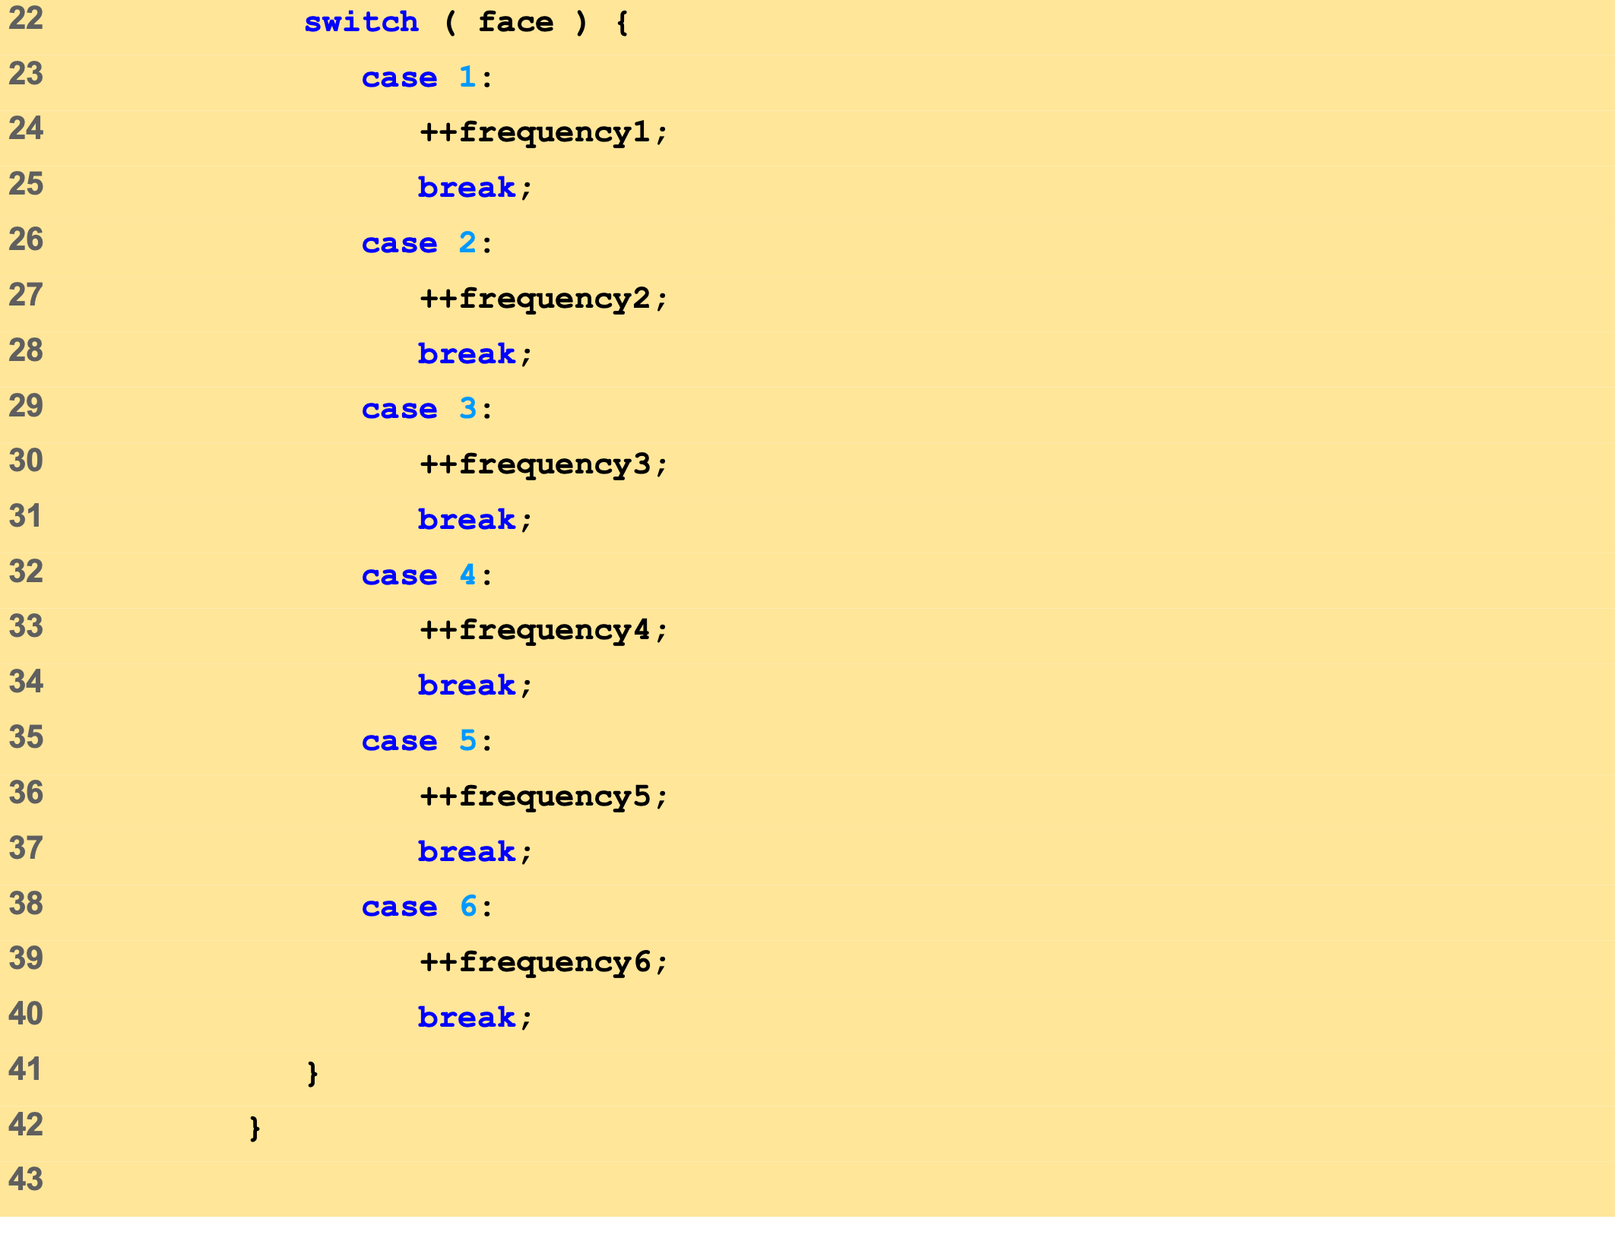
RollDie.html (2 of 3)
When the controlling expression, face, matches a case label, the respective frequency variable is incremented.

Slide 26
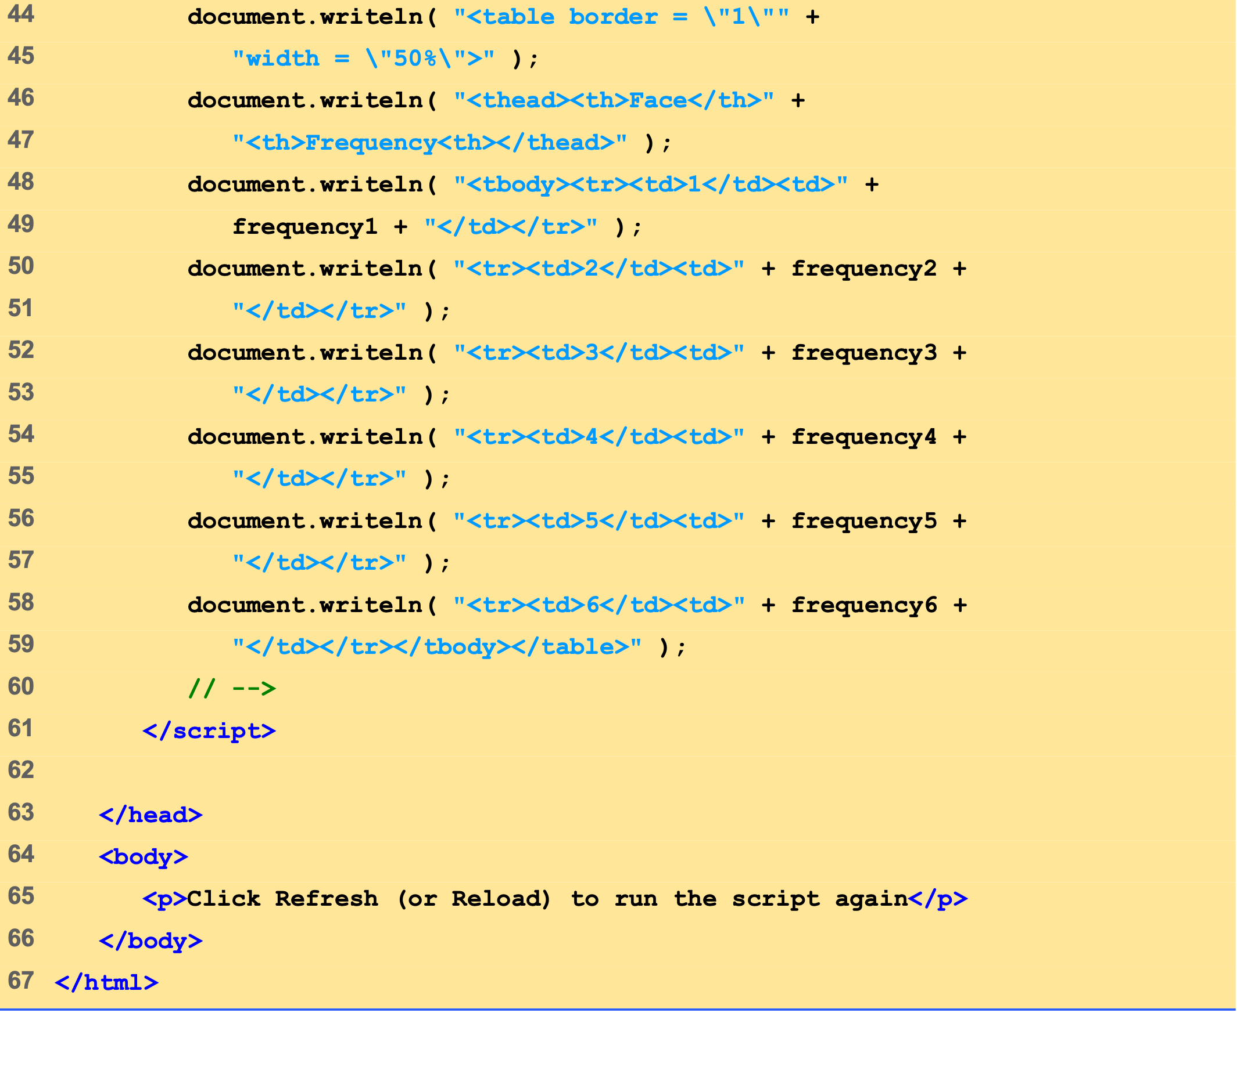
RollDie.html (3 of 3)
The results of rolling the die 600 times are displayed in a table.

Slide 27
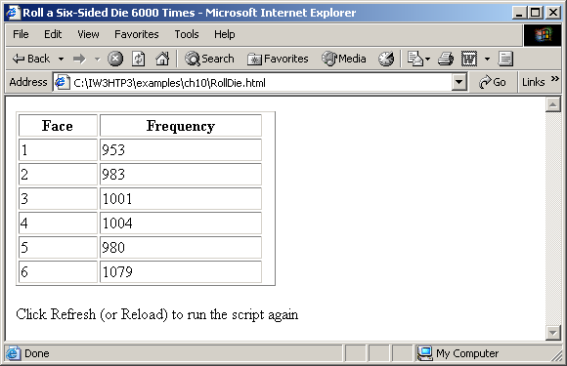
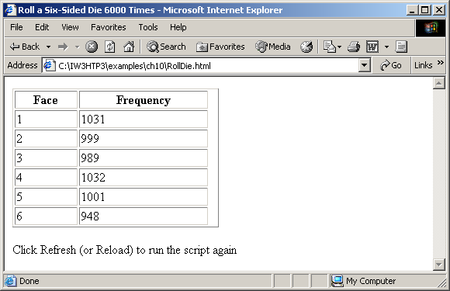
5 Random-Number Generation
Rolling a six-sided die 6000 times.

Slide 28
6 Example: Game of Chance
Craps
Click Roll Dice
Text fields show rolls, sum and point
Status bar displays results

Slide 29
6 Example: Game of Chance
Uses XHTML forms
Gather multiple inputs at once
Empty action attribute
name attribute allows scripts to interact with form
Event handling and event-driven programming
Assign a function to an event
Onclick
Constants
Variable that cannot be modified
Part of many languages, not supported in JavaScript
Name “constant” variables with all capital letters
Make values easier to remember/change

Slide 30
6 Example: Game of Chance
Changing properties
Access with dot (.) notation
value property of text fields
status property of window

Slide 31
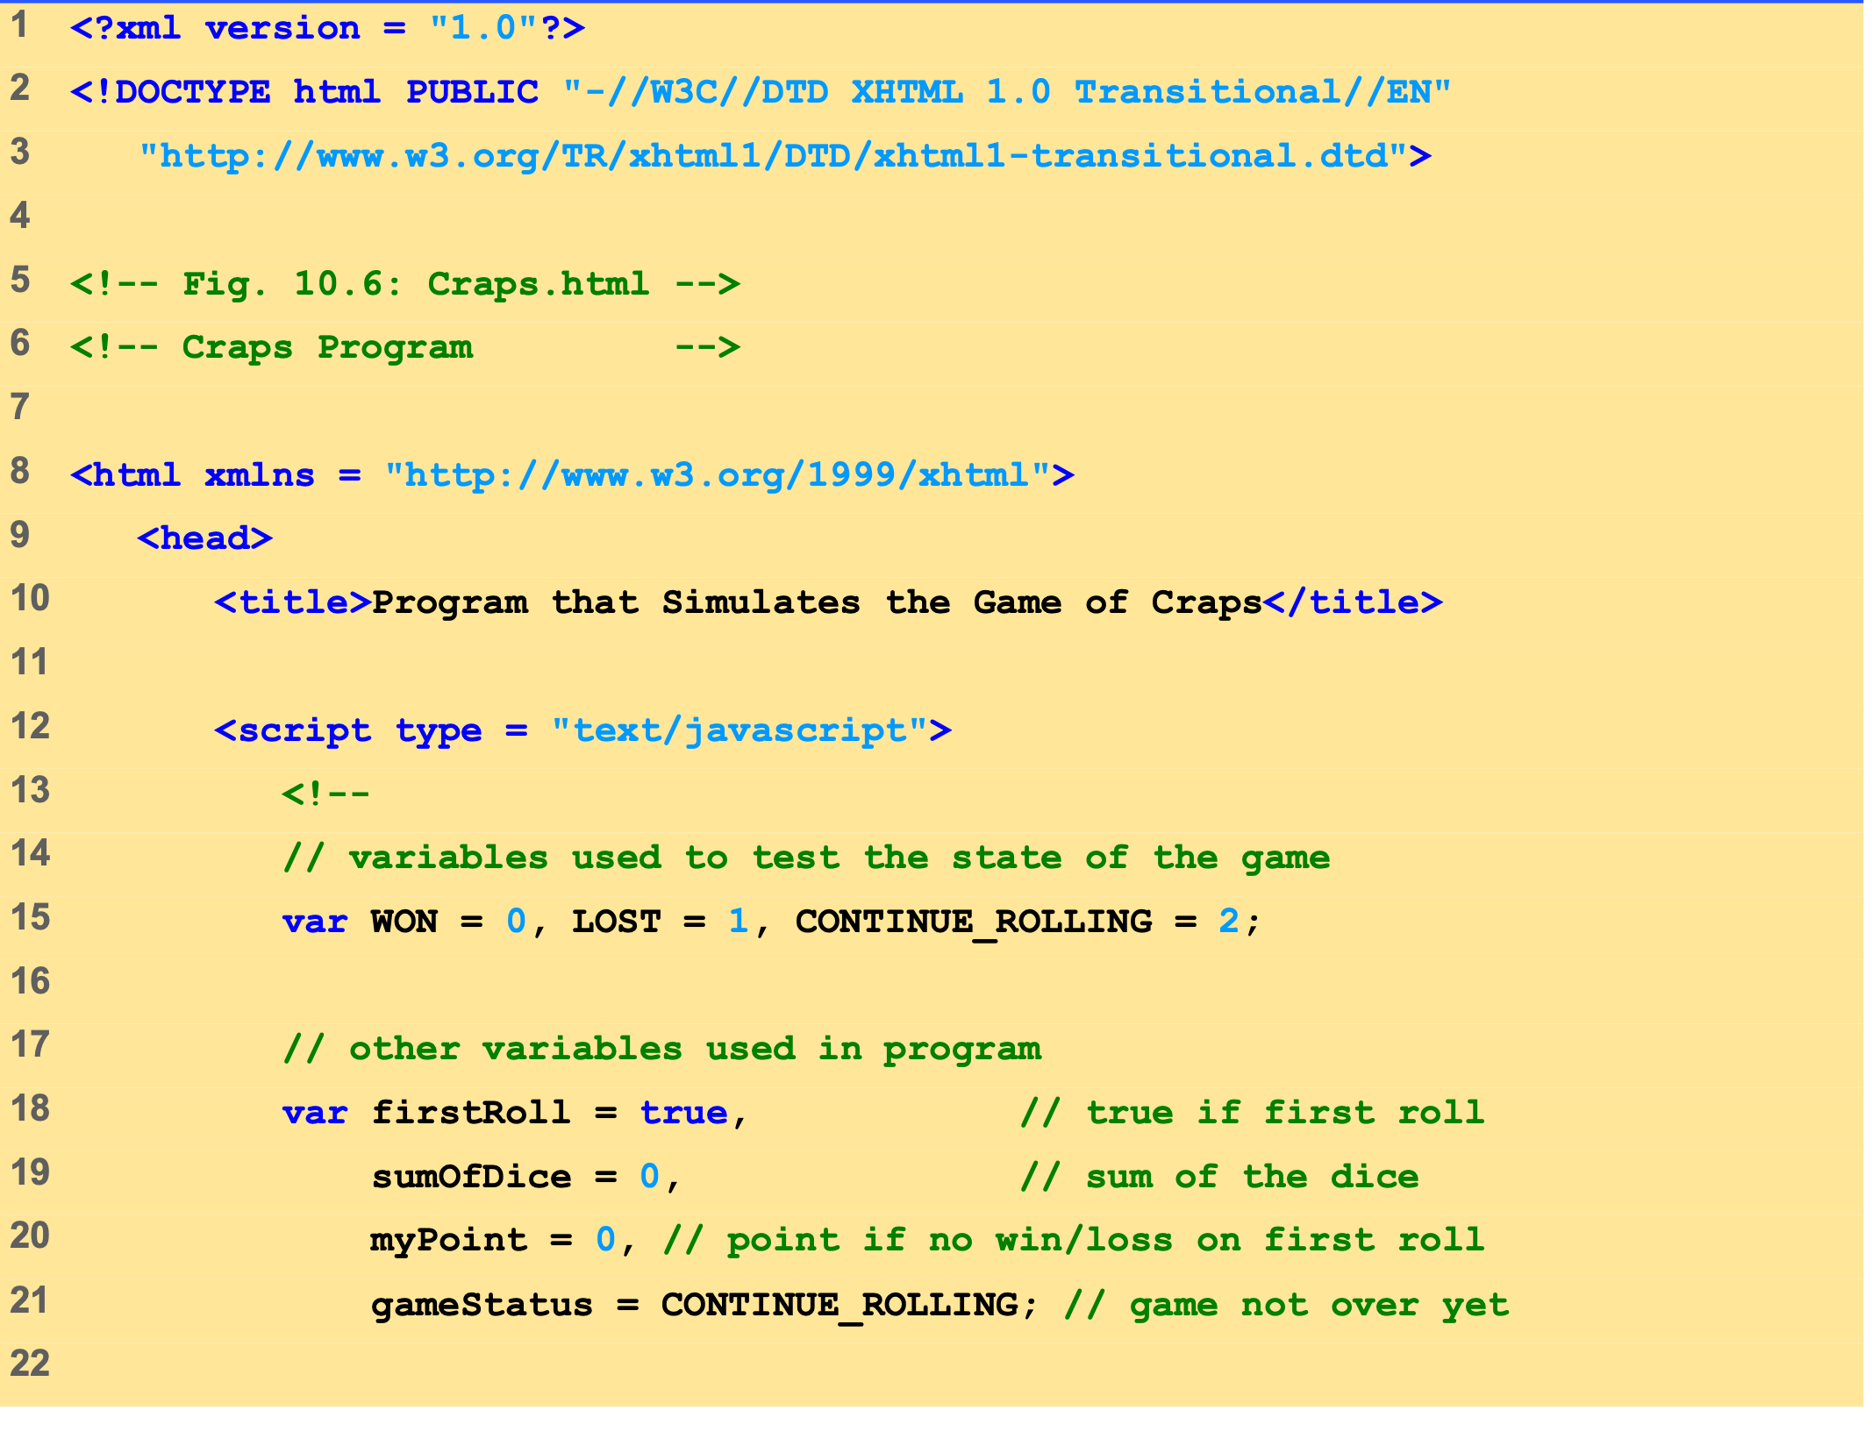
Craps.html (1 of 5)

Slide 32
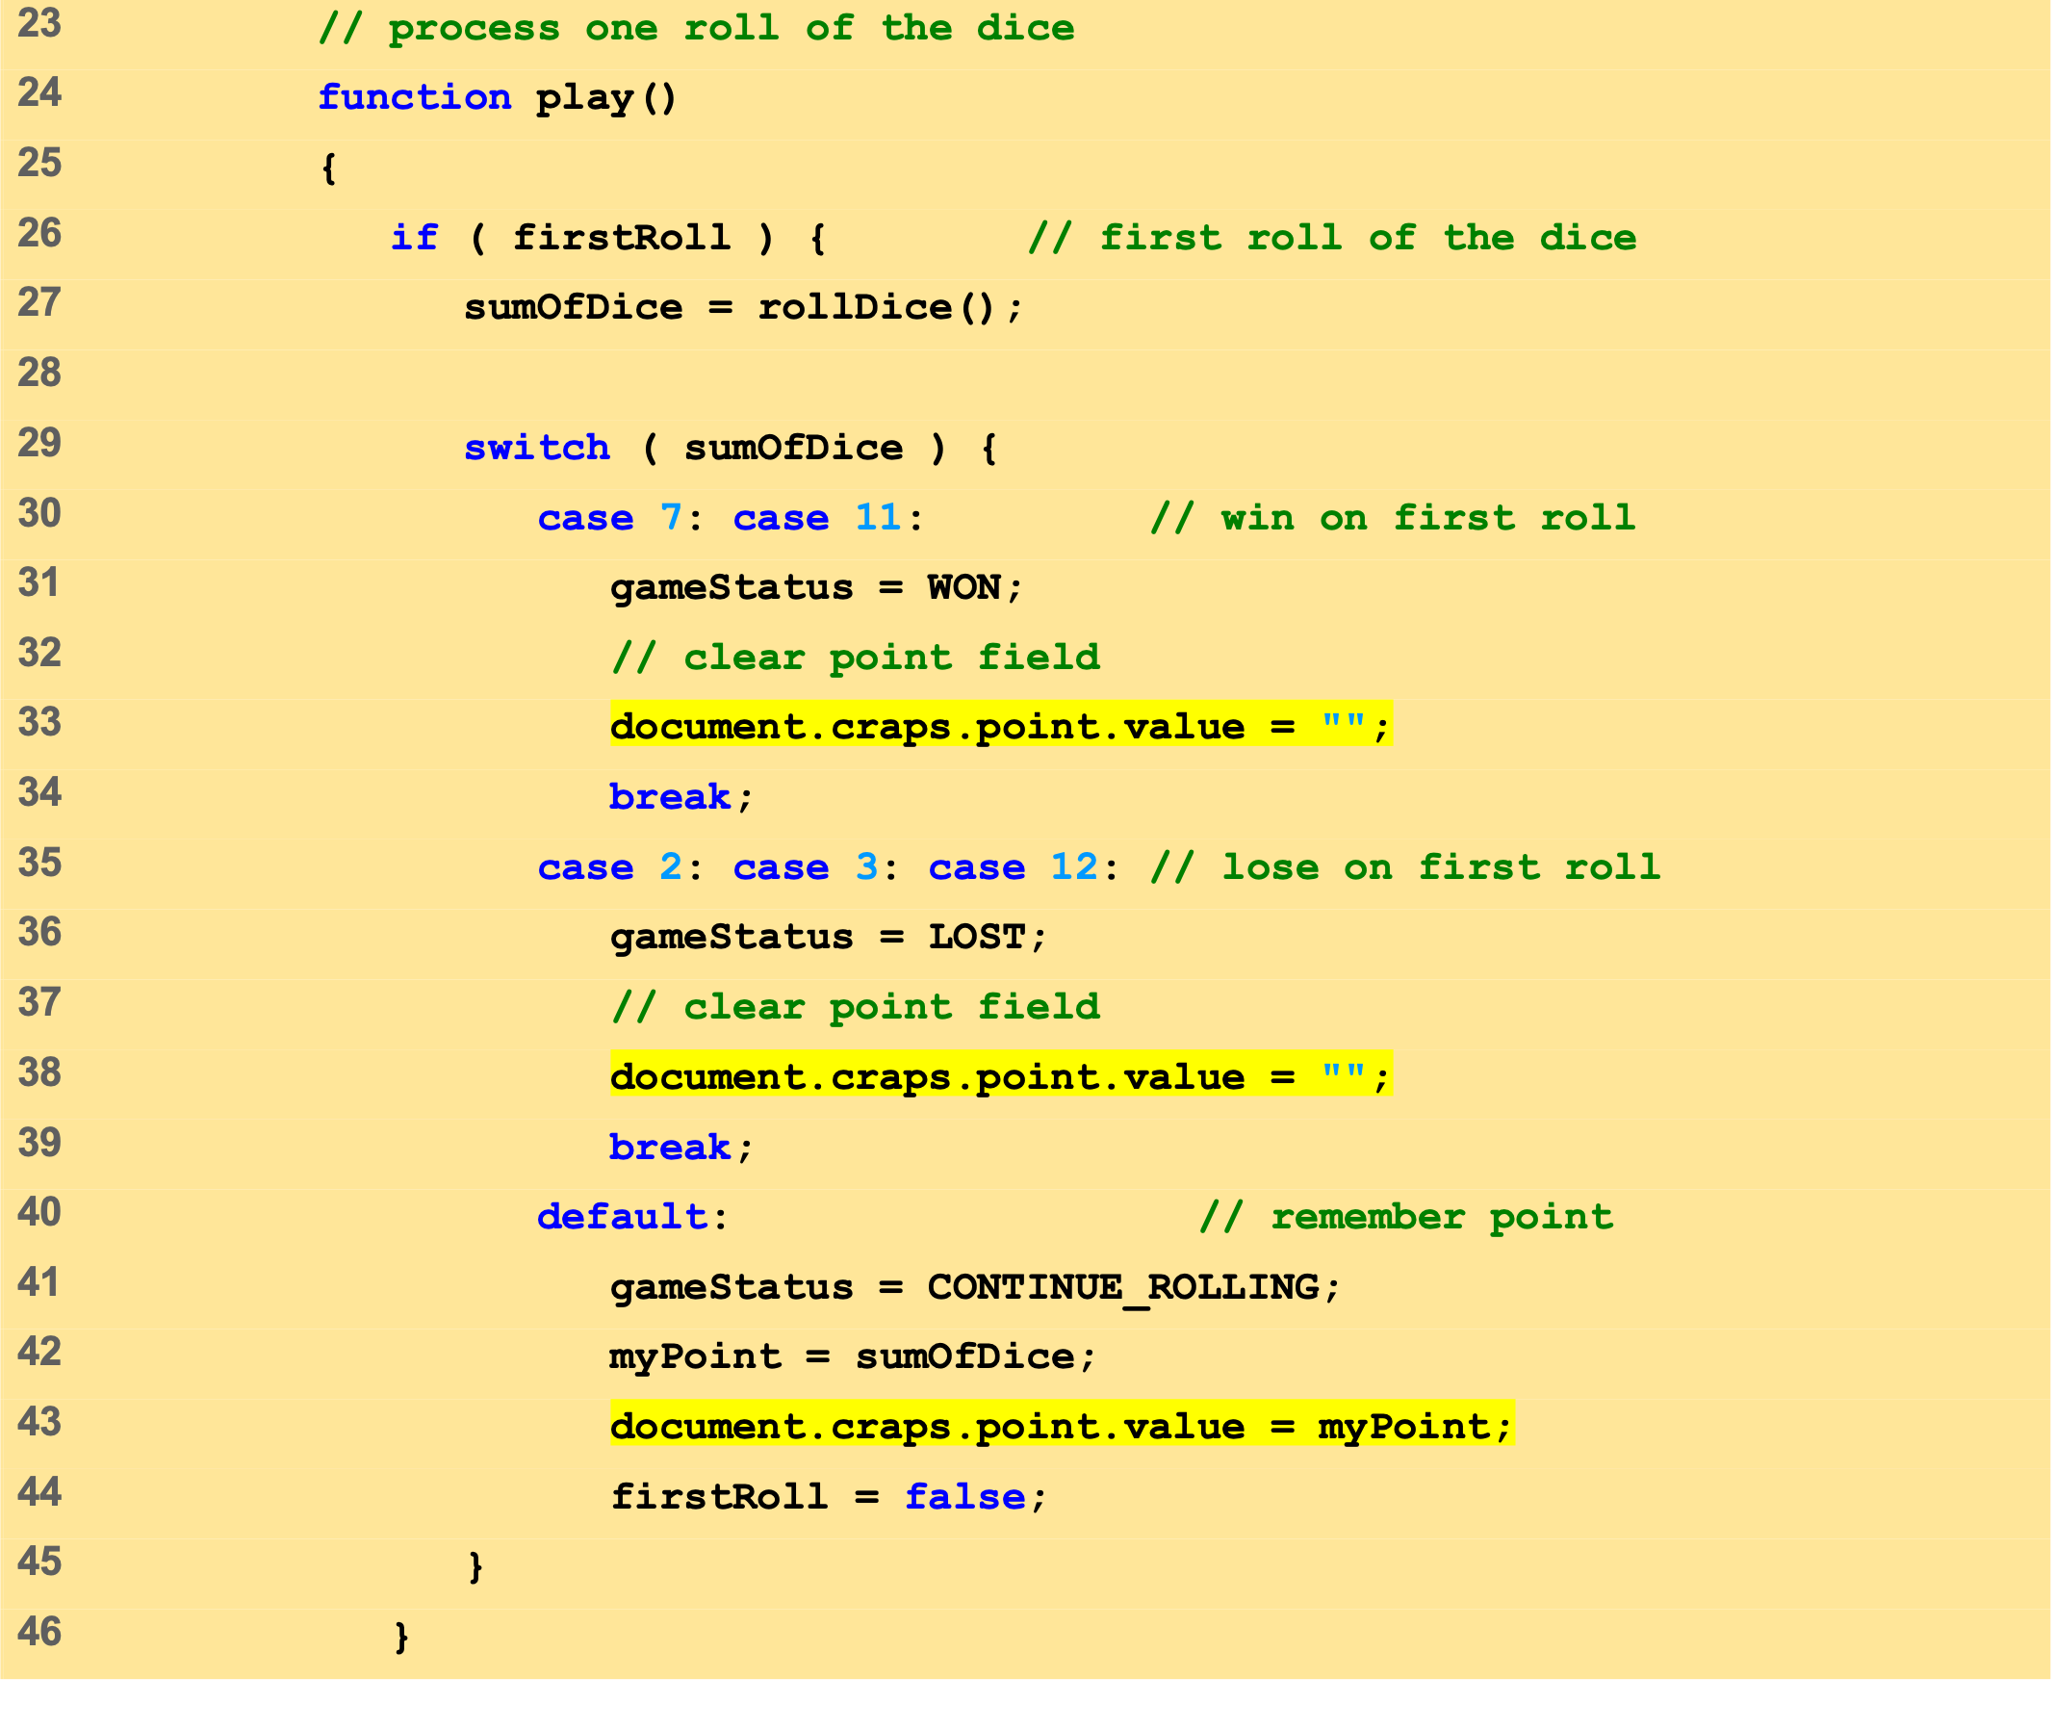
Craps.html (2 of 5)
If the value of firstRoll is true, then function rollDice is called.
If function rollDice returns a value of 7 or 11, the player wins and the break statement causes program control proceeds to the first line after the switch structure.
If function rollDice returns a 2, 3 or 12, the player loses and the break statement causes control to proceed to first line after the switch structure.

Slide 33
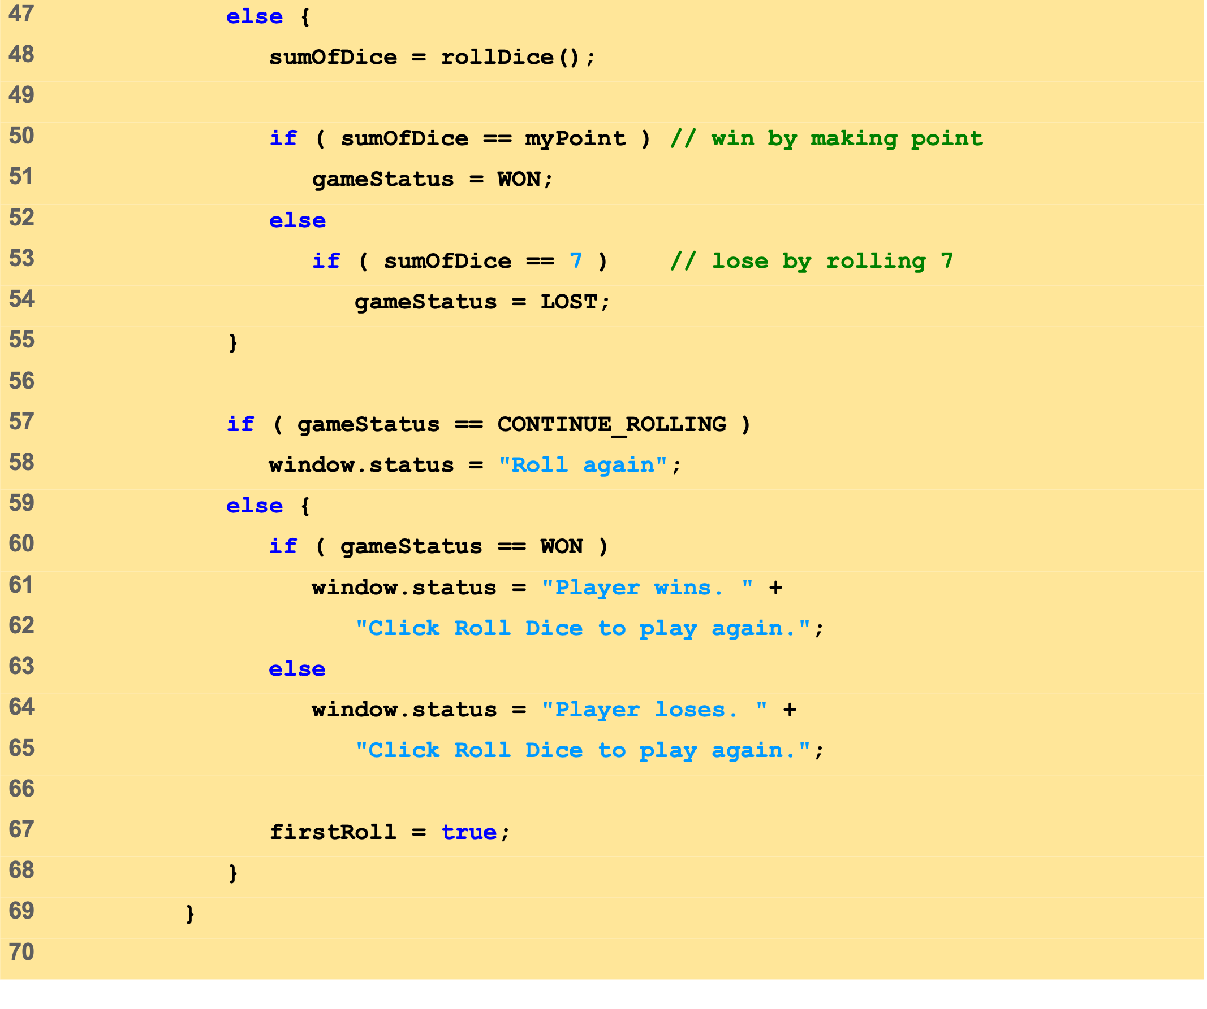
Craps.html (3 of 5)
If the value of firstRoll is false, function rollDice is called to see if the point has been reached.
If the values returned by function rollDice equals 7, the player loses.
If the value returned by function rollDice equals the value of variable myPoint, the player wins because the point has been reached.
window method status displays a message in the status bar of the browser.

Slide 34
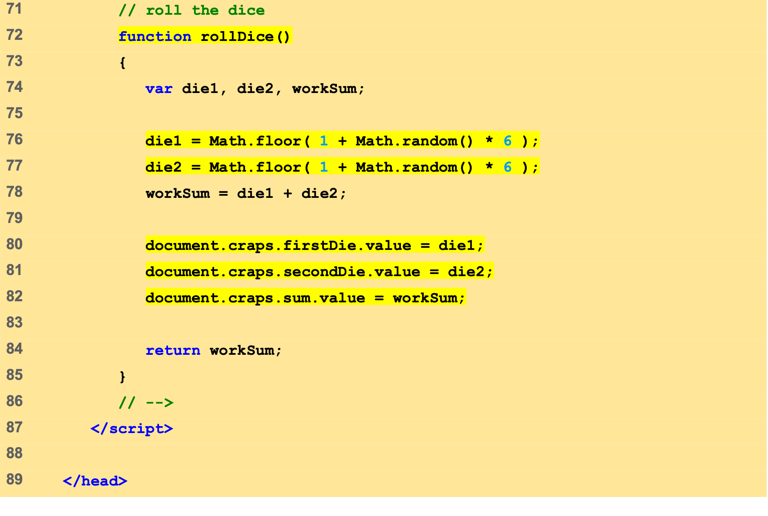
Craps.html (4 of 5)
Function rollDice is called to simulate the rolling of two dice on the craps table.
Methods random and floor are used to generate the values for the two dice.
Referencing the names of form elements in the XHTML document, the values of the dice are placed in their respective form fields.

Slide 35
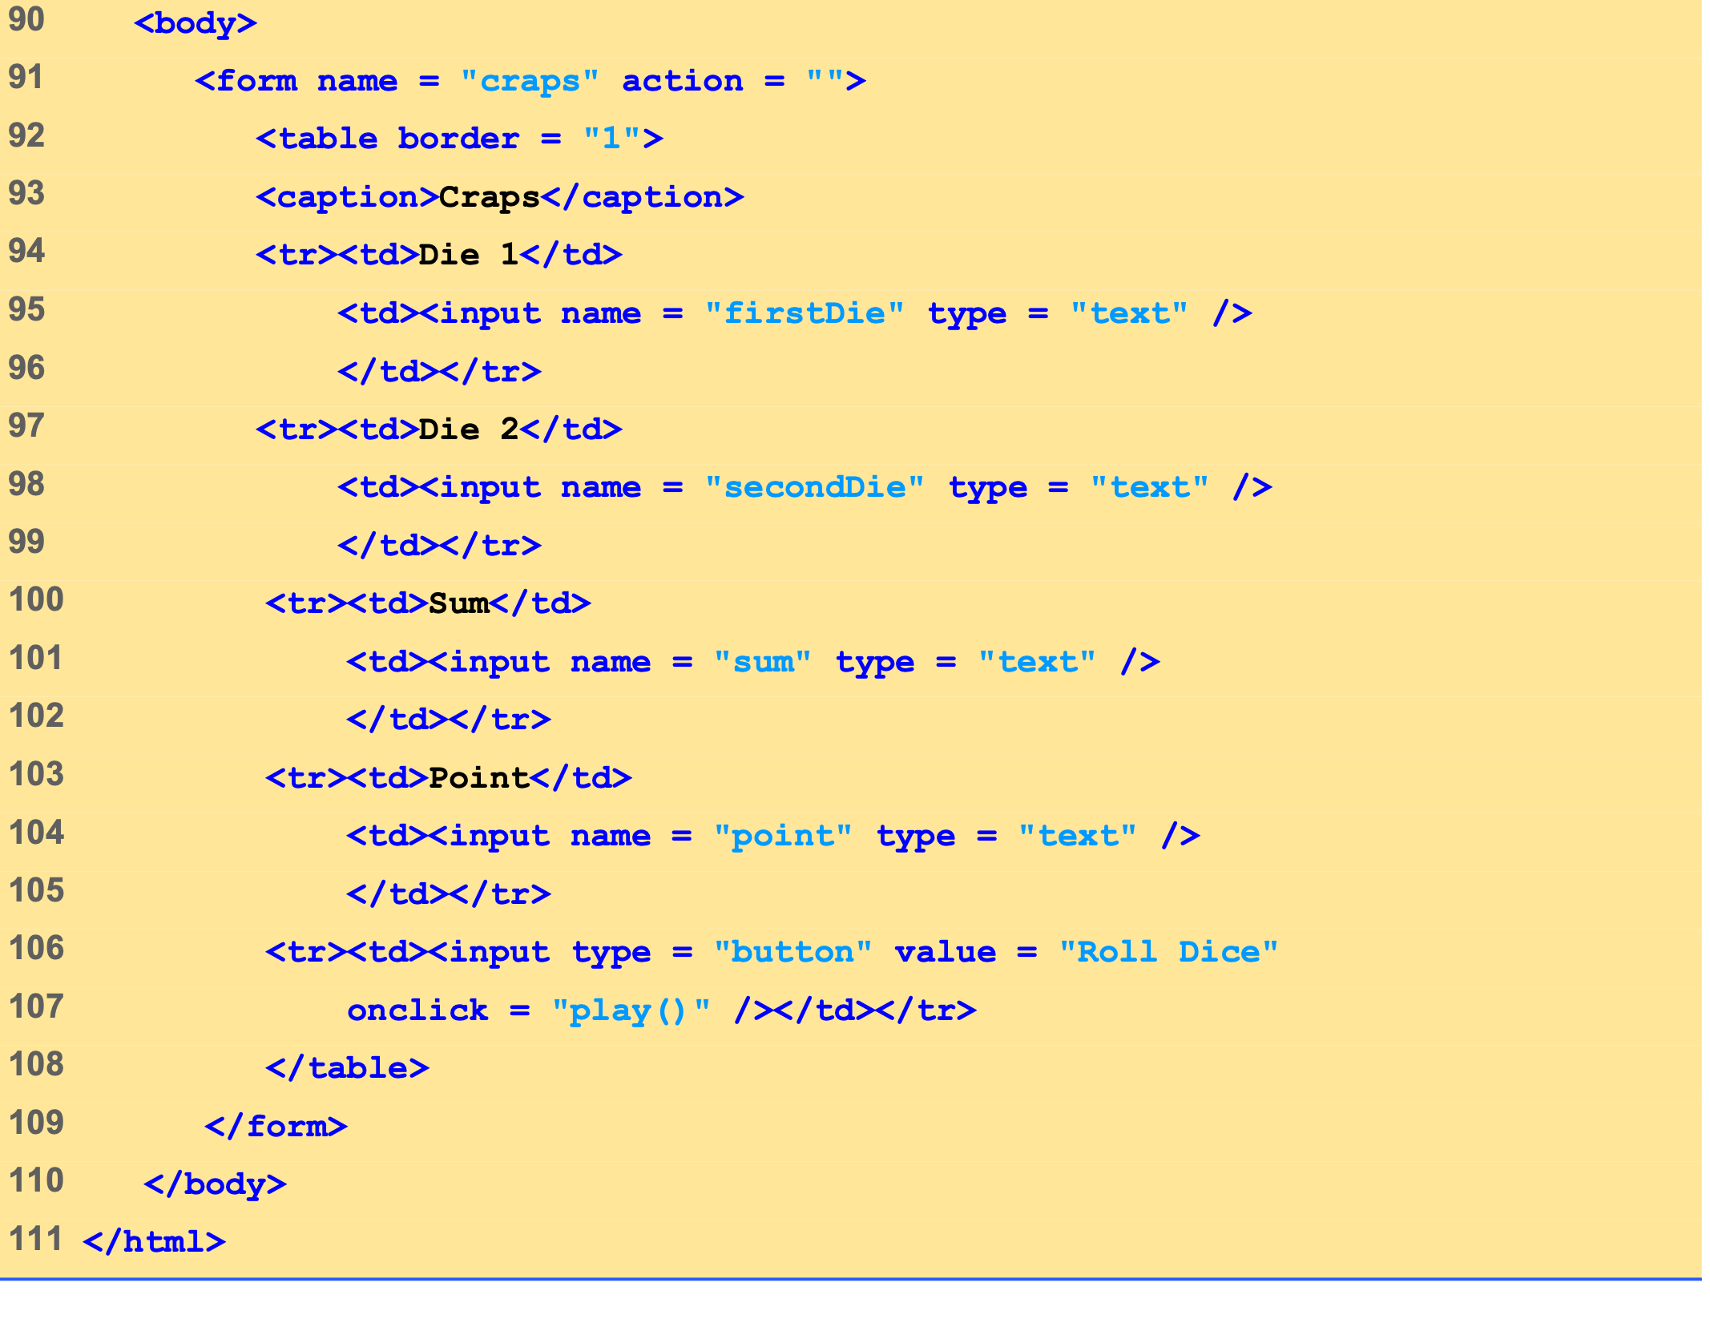
Craps.html (5 of 5)

Slide 36
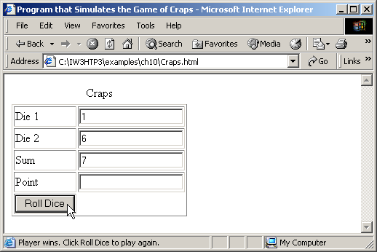
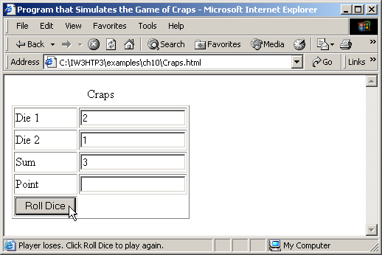
6 Example: Game of Chance
Craps game simulation.
A text XHTML GUI component
A button XHTML GUI component
Browser’s status bar

Slide 37
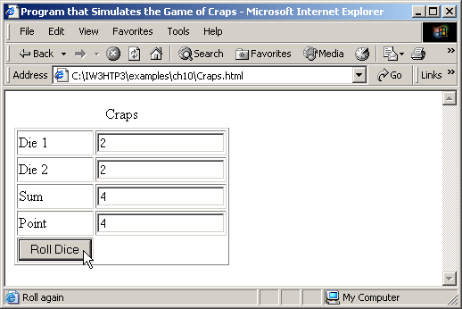
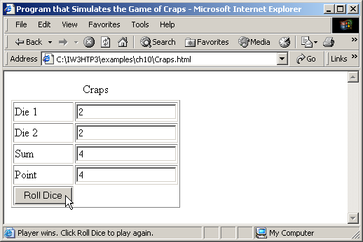
6 Example: Game of Chance
Craps game simulation.

Slide 38


6 Example: Game of Chance
Craps game simulation.

Slide 39
7 Another Example: Random Image Generator
Randomly selecting an image
Images have integer names (i.e., 1.gif, 2.gif, …, 7.gif)
Generate random number in proper range
Update src property

Slide 40
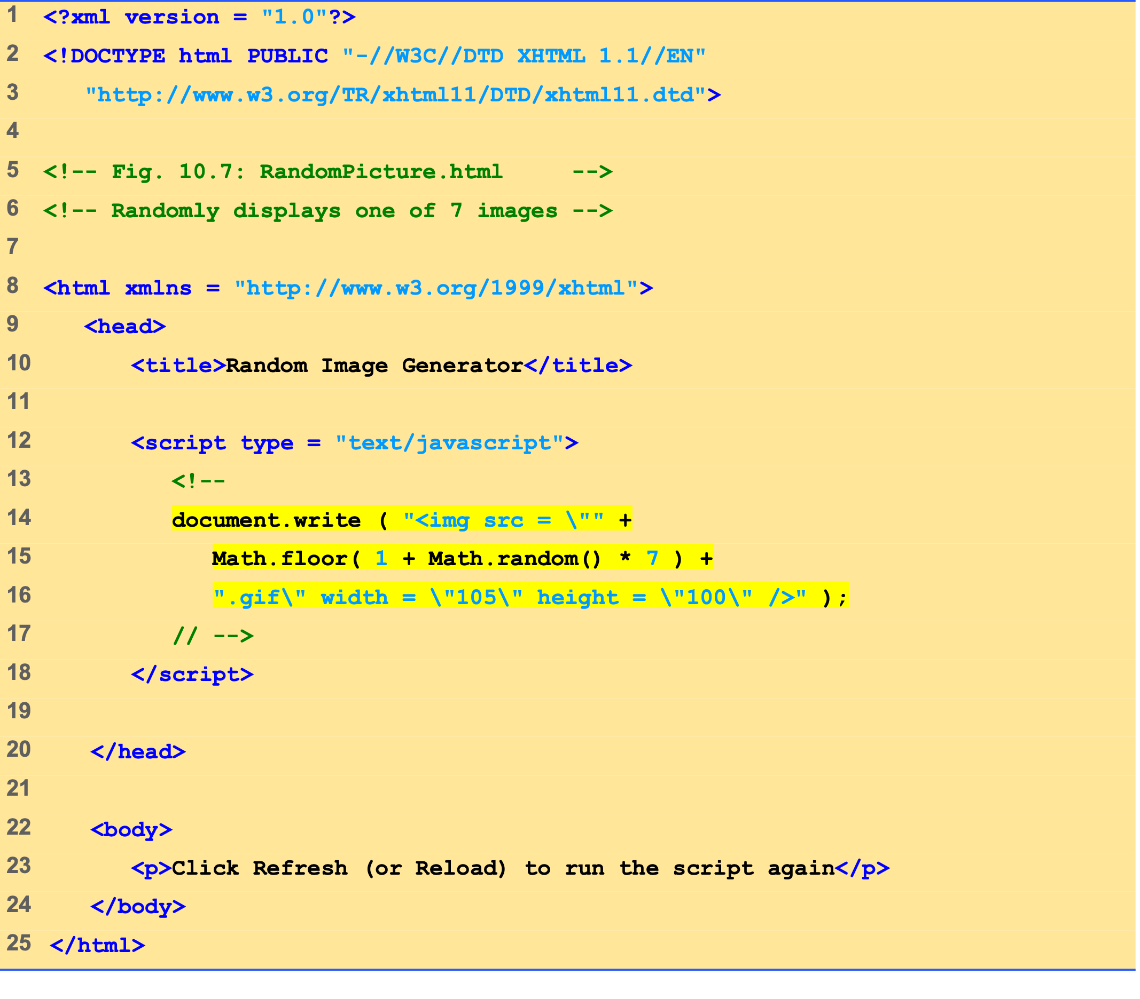
RandomPicture.html (1 of 1)
Inserting a random number into the image’s src property with document.write and Math.random

Slide 41
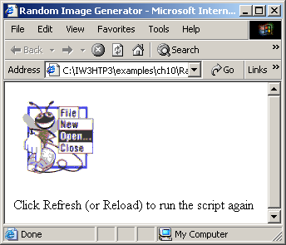
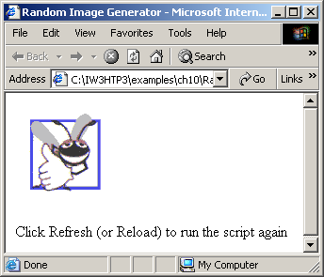
7 Another Example: Random Image Generator
Random image generation using Math.random.

Slide 42
8 Scope Rules
Scope
Portion of program where identifier can be referenced
Inside function is local or function scope
Identifiers exist only between opening and closing braces
Local variables hide global variables

Slide 43
8 Scope Rules
Scope demonstration
Global variable x initialized to 1
start has local variable x initialized to 5
functionA has local variable x initialized to 25
functionB has no local variable x
Observe output of each function

Slide 44
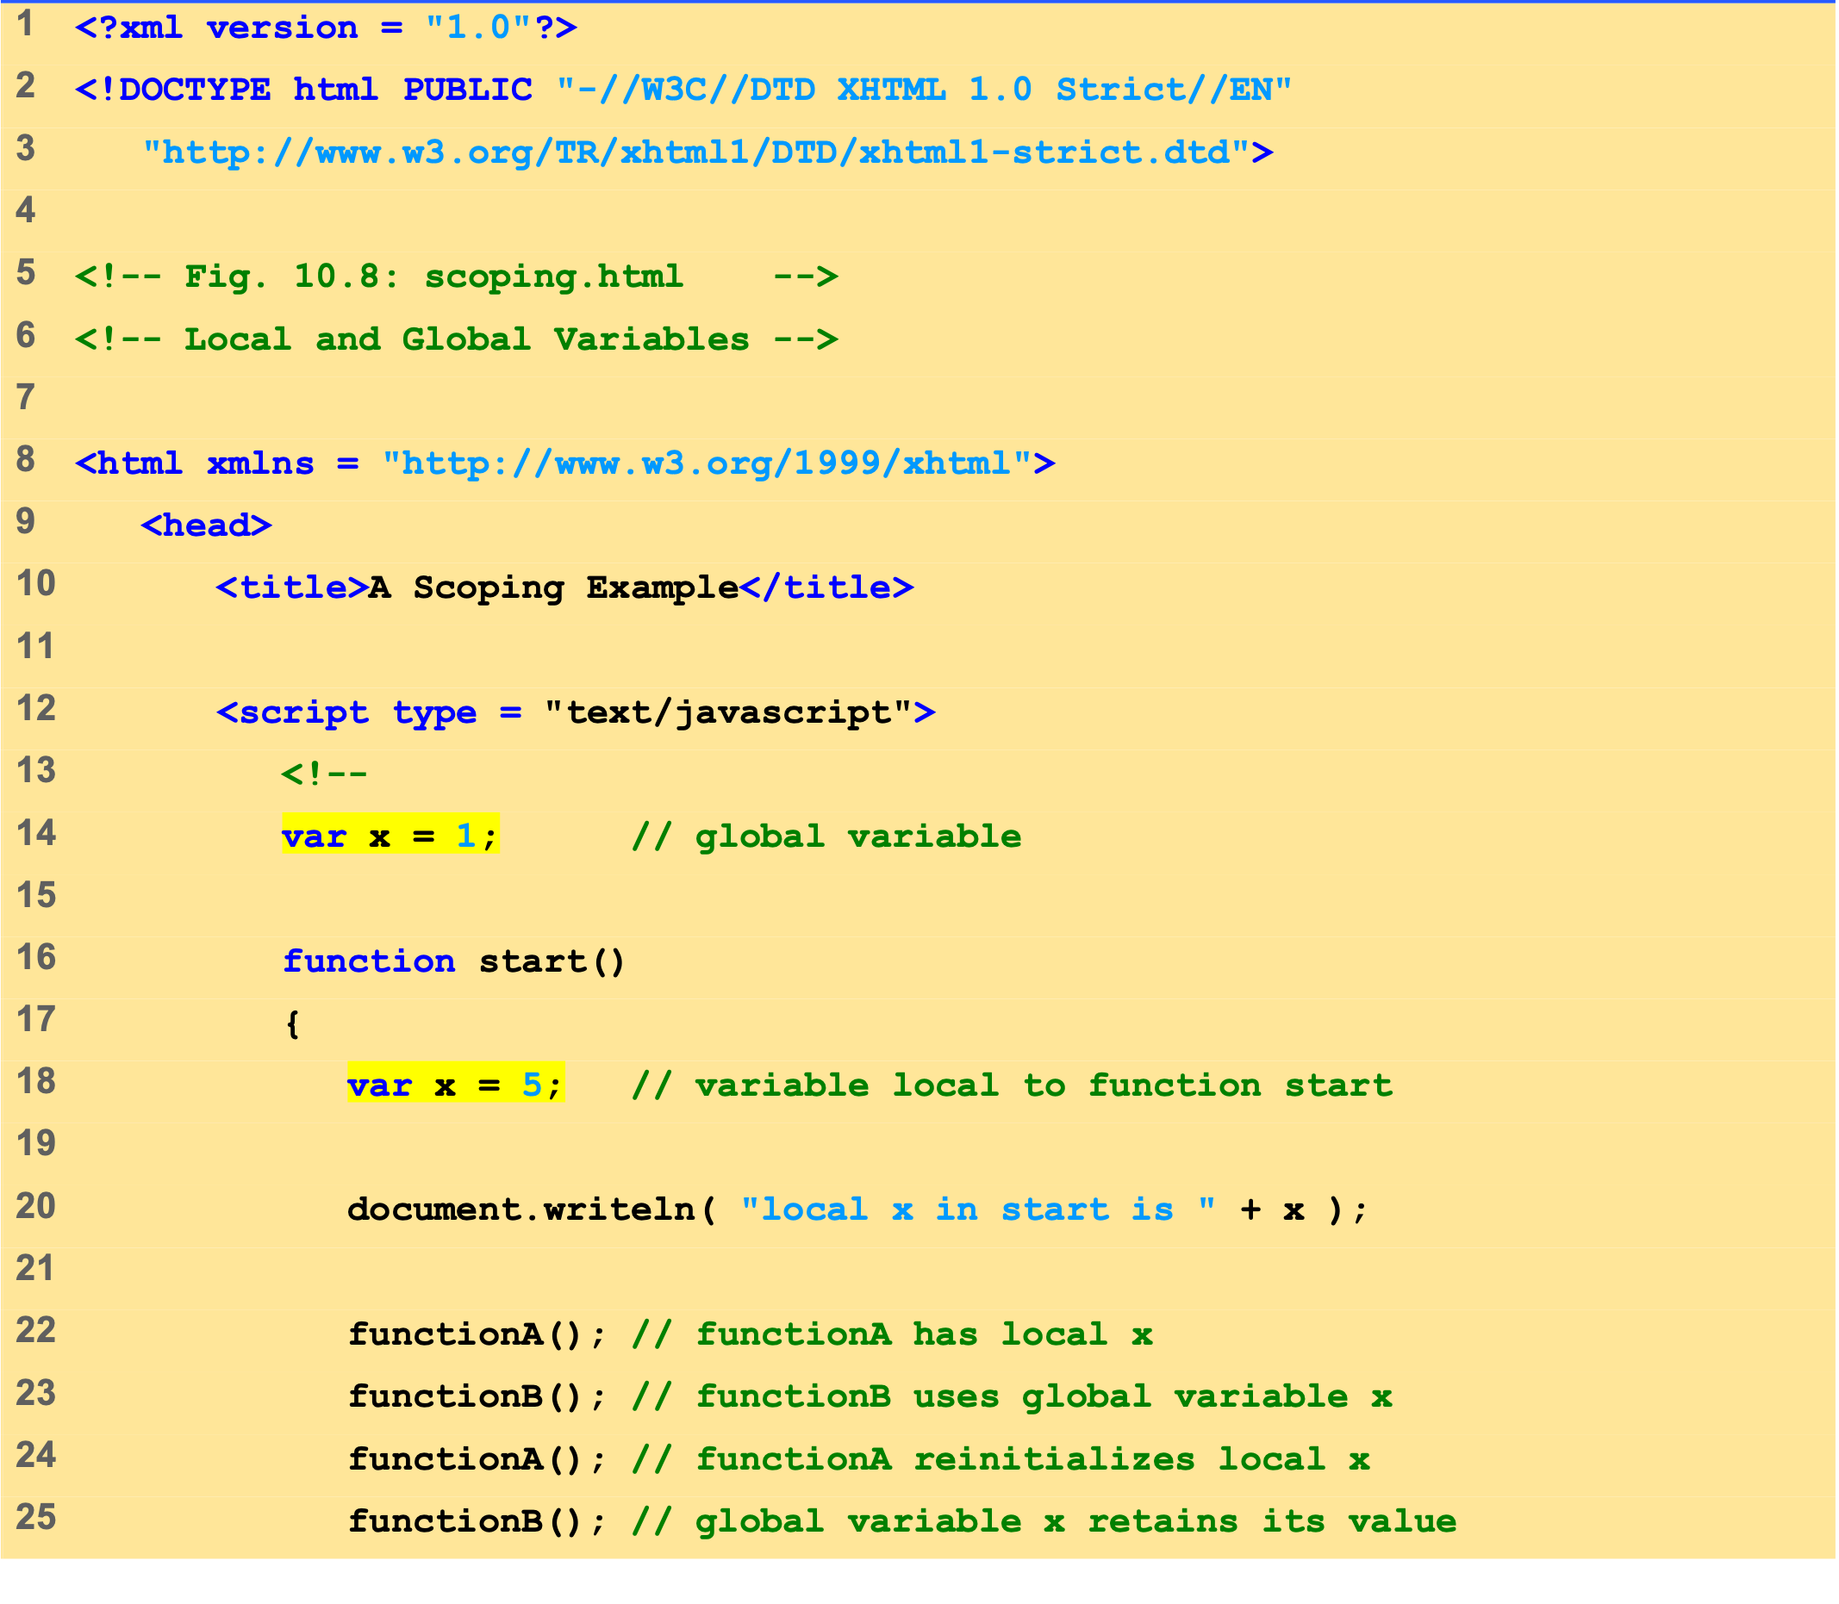
Scoping.html (1 of 3)
To begin the program, variable x is initialized to 1.
Function start changes the value of x to 5.

Slide 45
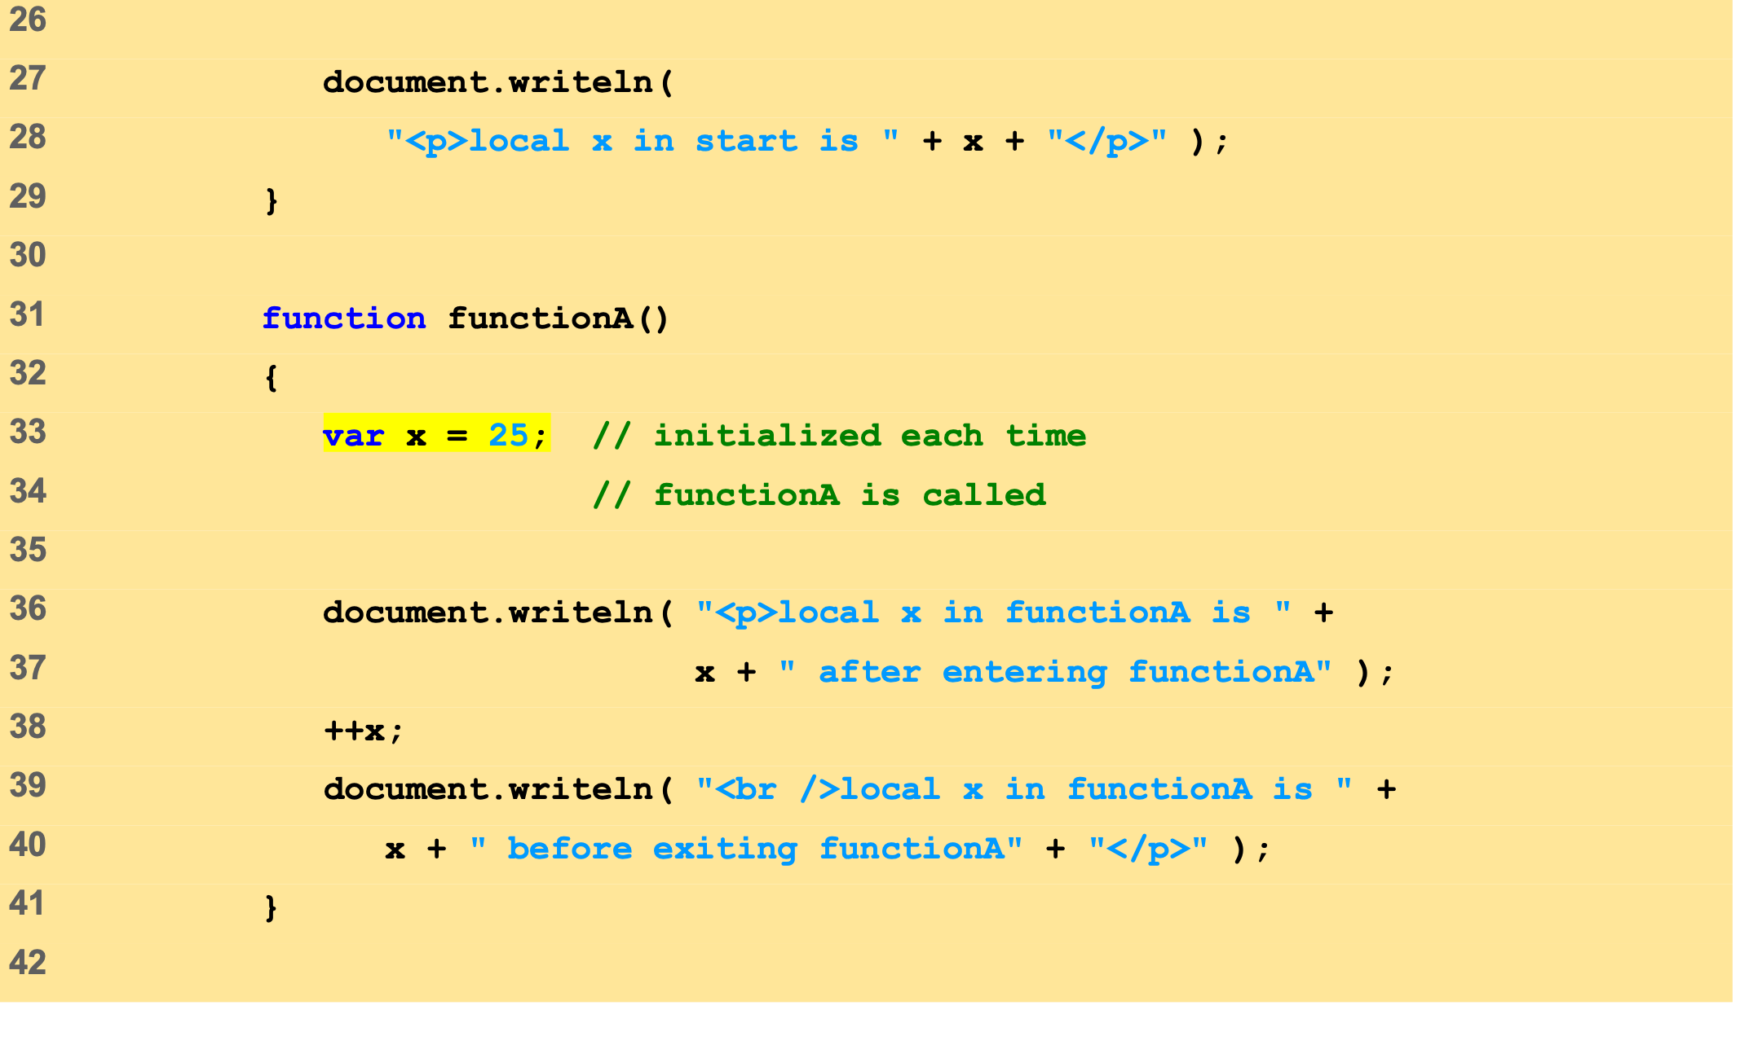
Scoping.html (2 of 3)
Function functionA changes the value of x to 25.
The value of x is incremented.

Slide 46
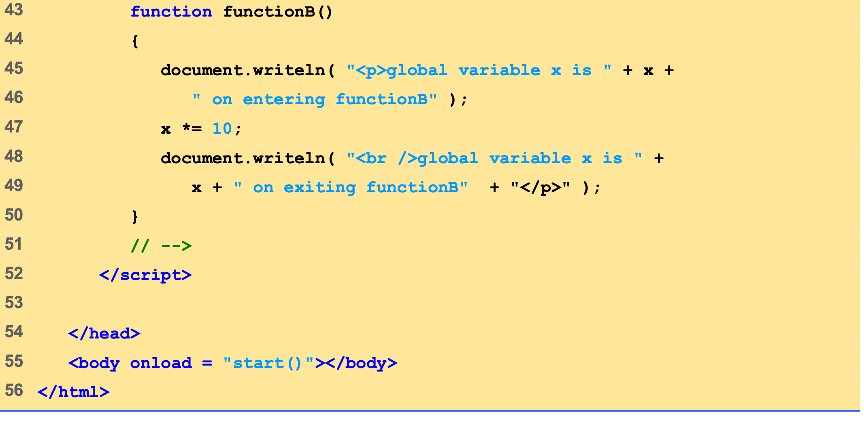
Scoping.html (3 of 3)
Function functionB multiplies the value of x by 10.

Slide 47
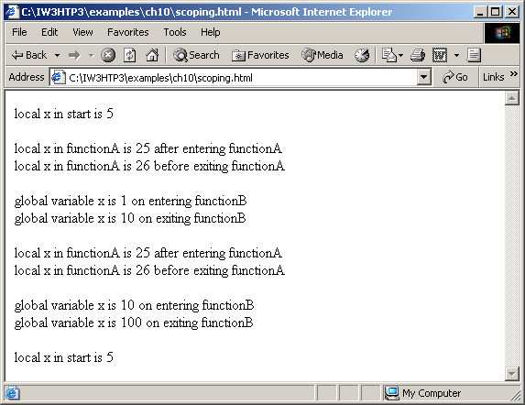
8 Scope Rules
Scoping example.

Slide 48
9 JavaScript Global Functions
Global object
Always available
Provides 7 methods
Do not need to explicitly reference Global before method call
Also holds all global variables, user defined functions

Slide 49
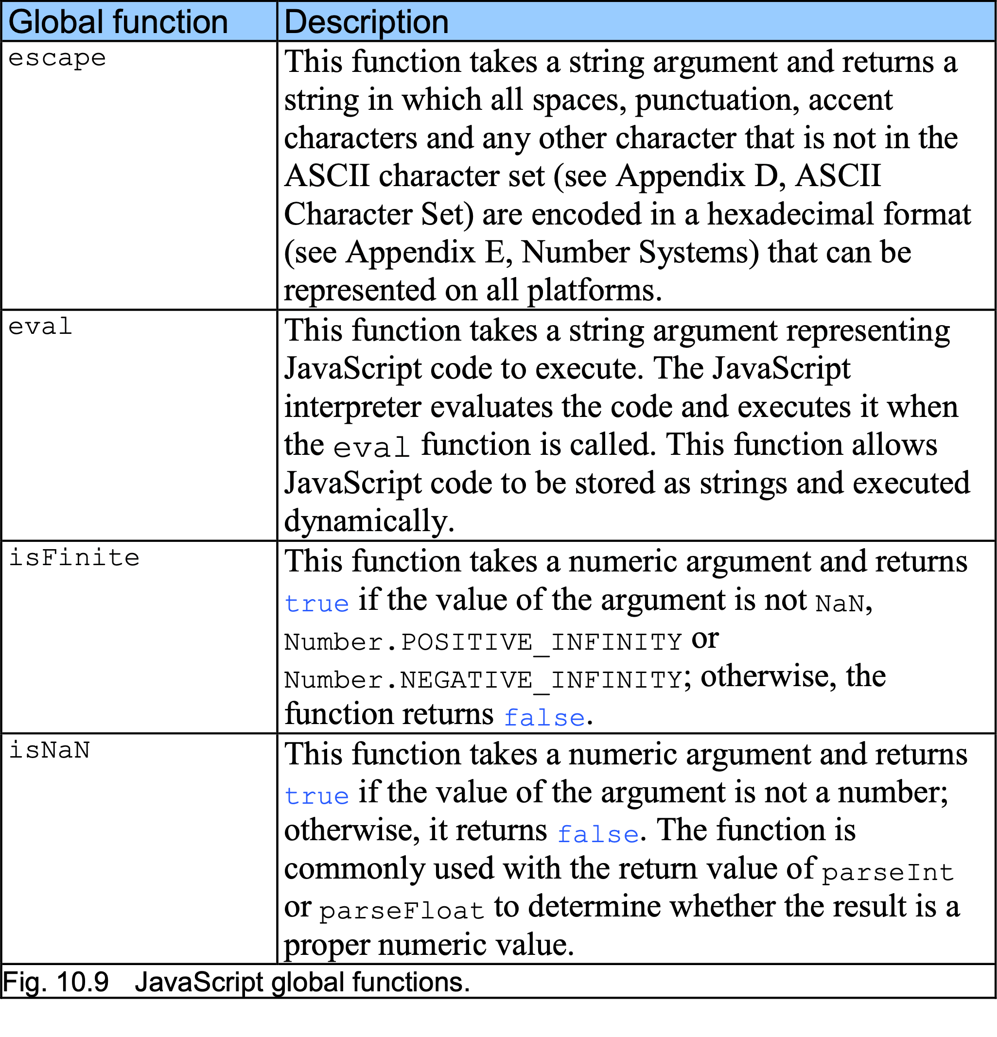
9 JavaScript Global Functions

Slide 50
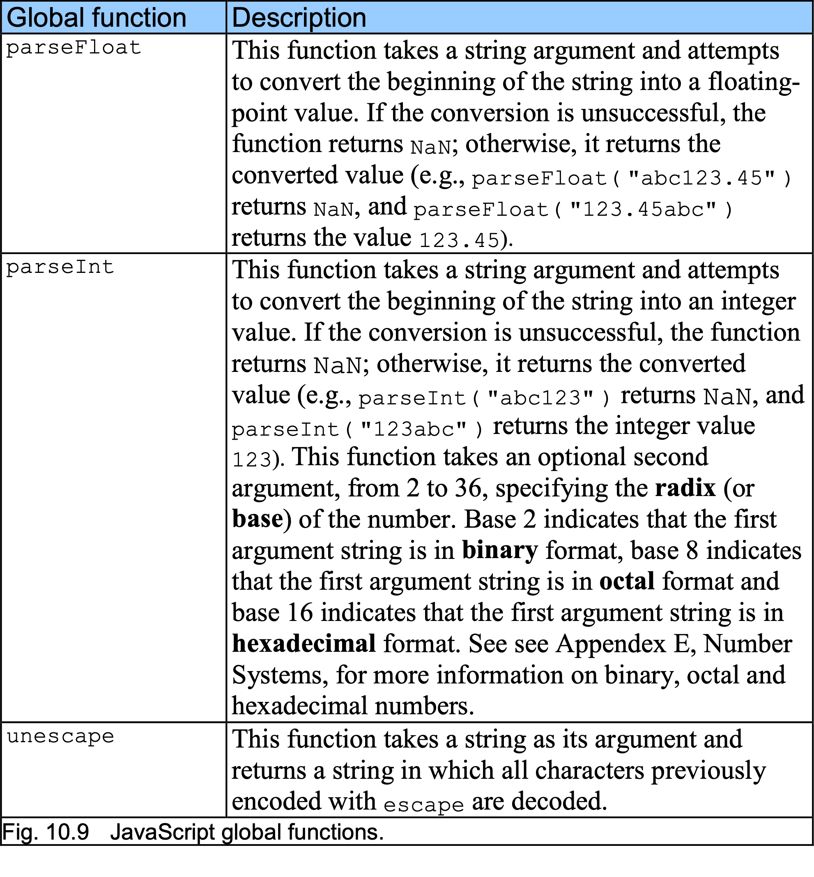
9 JavaScript Global Functions

Slide 51
10 Recursion
Recursive functions
Call themselves
Recursion step or recursive call
Part of return statement
Must have base case
Simplest case of problem
Returns value rather than calling itself
Each recursive call simplifies input
When simplified to base case, functions return

Slide 52
10 Recursion
Factorials
Product of calculation n · (n - 1) · (n - 2) · … · 1
Iterative approach:
var factorial = 1; for ( var counter = number; counter >= 1; --counter ) factorial *= counter;
Note each factor is one less than previous factor
Stops at 1: base case
Perfect candidate for recursive solution

Slide 53
10 Recursion
Final value = 120
5!
5!
5! = 5 * 24 = 120 is returned
5 * 4!
5 * 4!
4! = 4 * 6 = 24 is returned
4 * 3!
4 * 3!
3! = 3 * 2 = 6 is returned
3 * 2!
3 * 2!
2! = 2 * 1 = 2 is returned
2 * 1!
2 * 1!
1 returned
1
1
(a) Procession of recursive calls.
(b) Values returned from each recursive call.
Recursive evaluation of 5!.

Slide 54
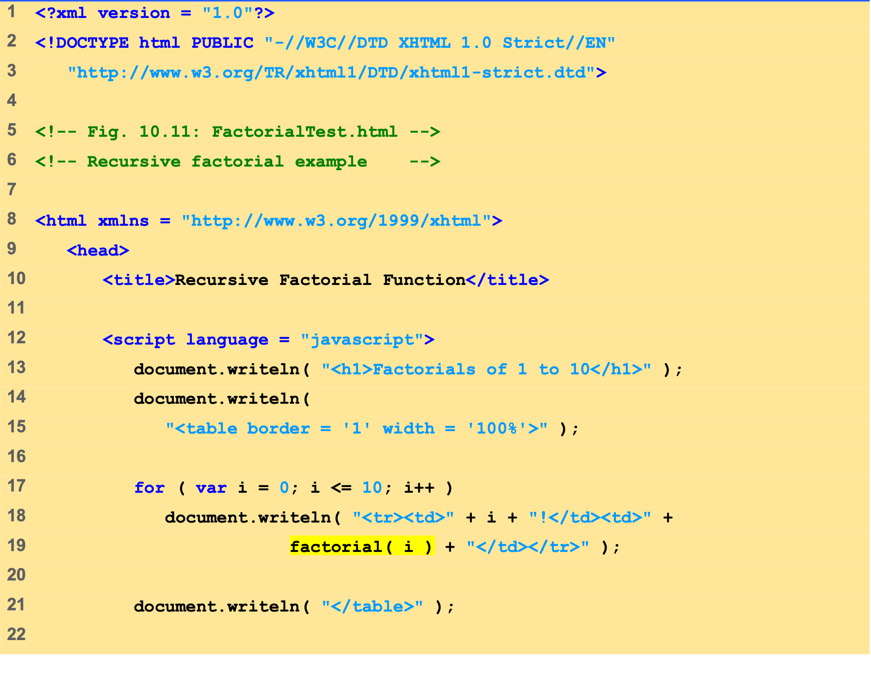
FactorialTest.html (1 of 2)
Calling function factorial and passing it the value of i.

Slide 55
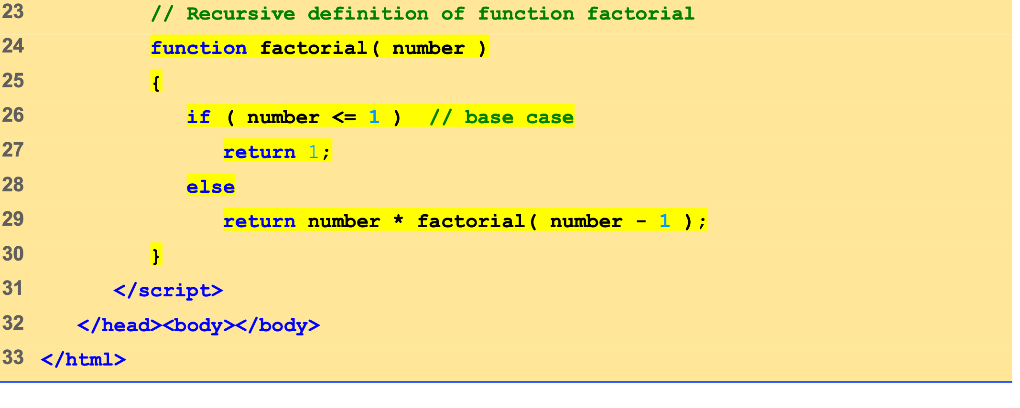
FactorialTest.html (2 of 2)
Variable number gets the value of variable i.
Call to function factorial and passing it 1 less than the current value of number .

Slide 56
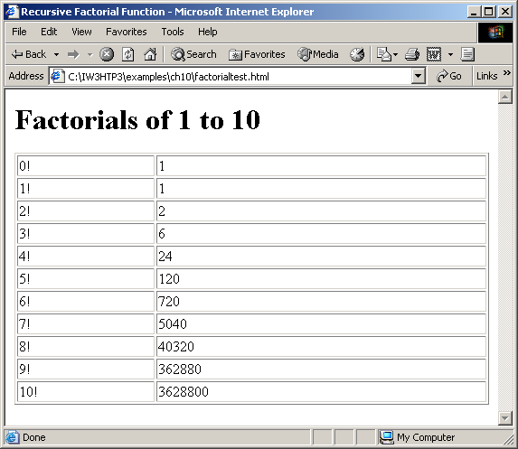
10 Recursion
Factorial calculation with a recursive function.

Slide 57
11 Recursion vs. Iteration
Iteration
Explicitly uses repetition structures to achieve result
Terminates when loop-continuation condition fails
Often faster than recursion
Recursion
Repeats through function calls
Terminates when base case reached
Slower due to function call overhead
Each call generates new copy of local variables
Easy to read and debug when modeling problem with naturally recursive solution

Slide 58
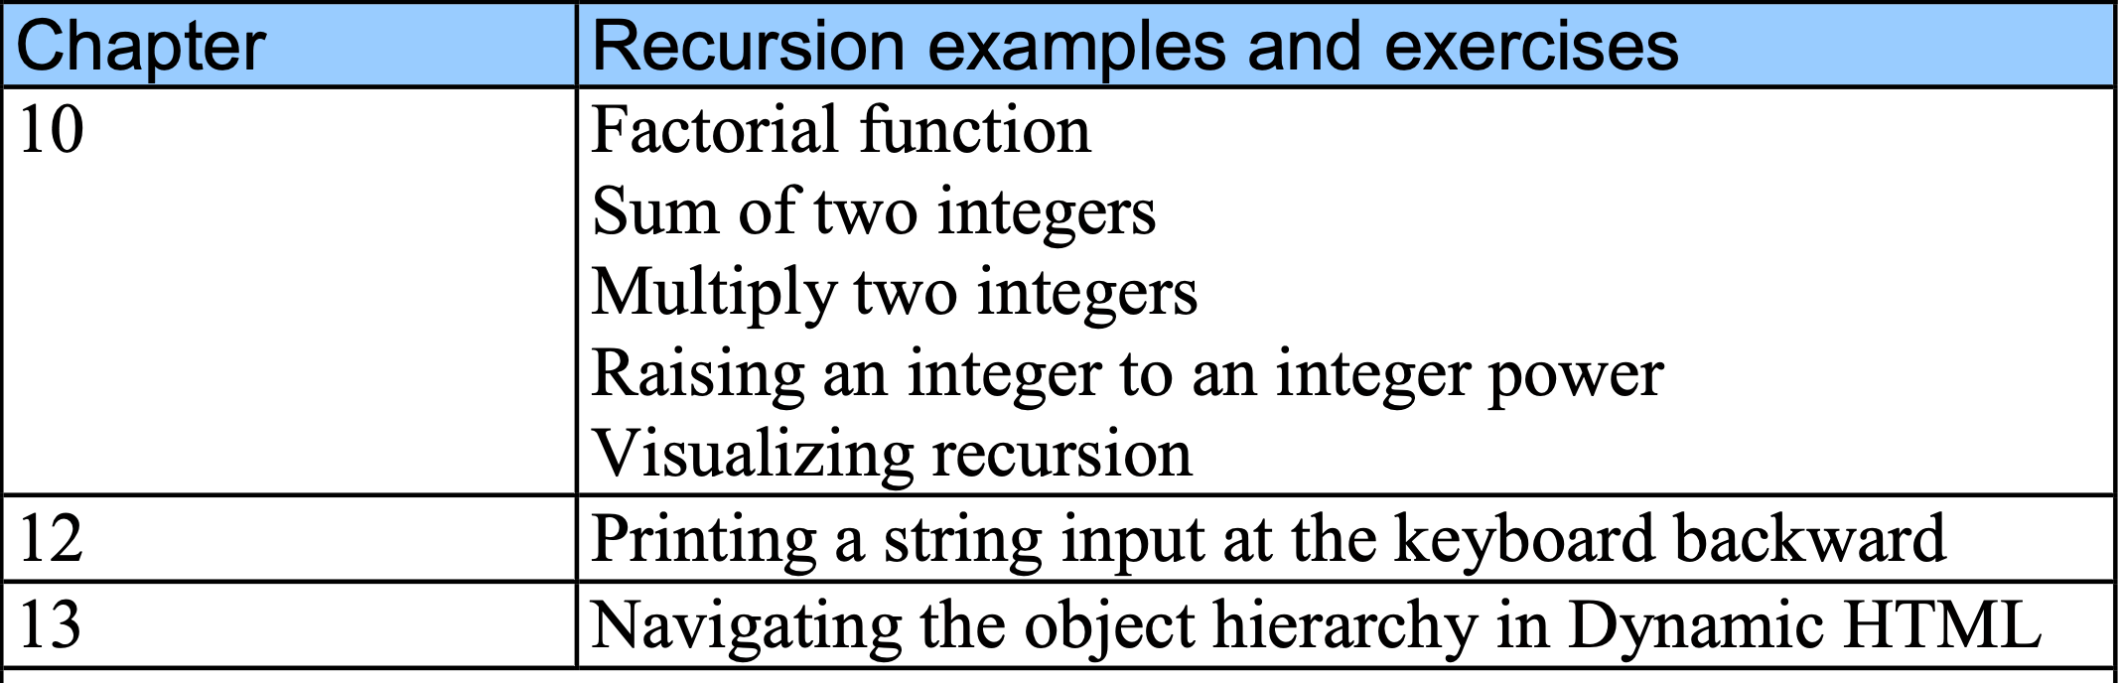
11 Recursion vs. Iteration

Slide 59
14 Web Resources
www.javascriptmall.com
developer.netscape.com/tech/javascript
www.mozilla.org/js/language
Deitel and deitel, Internet and World Wide Web How to Program: Third Edition

